Slide 1
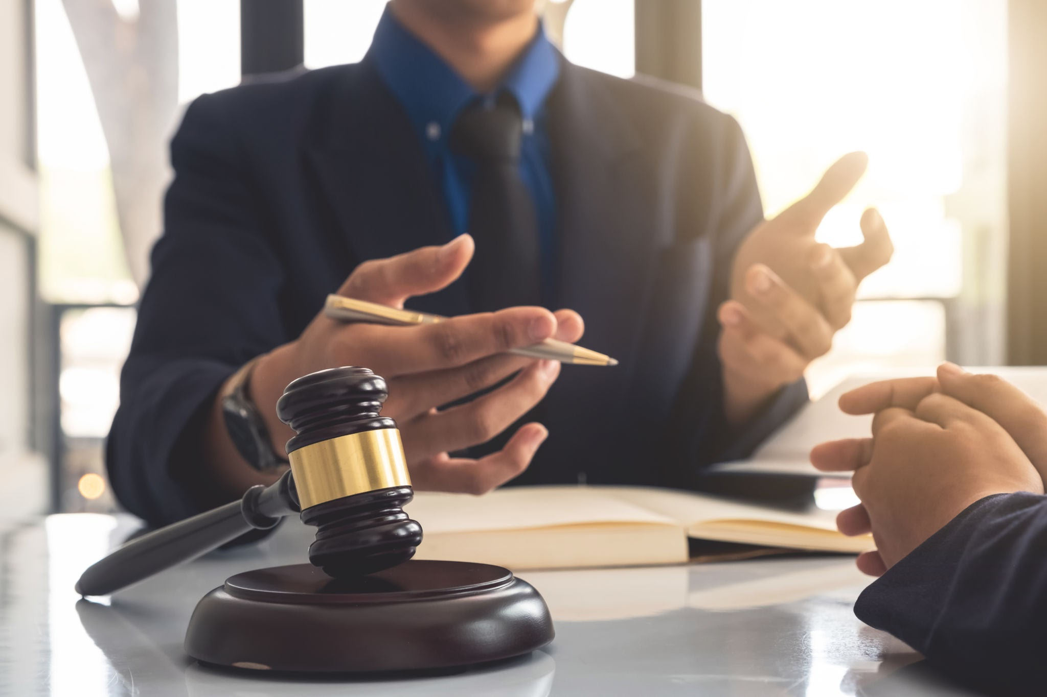
Right to Effective Counsel Lesson

Slide 2
School Graffiti Fiasco: A Teacher who gives a student poor advice?
Let’s read the script and then go over the questions together
Would you want a person who is on your side present with you? A trusted adult, counselor, parent, or lawyer? Why/why not? Do you need one?
When would you want a trusted adult? Principal's office? School Security Officer? Arrest? At the jail? At the trial? Before the trial? How long before the trial?
Should the trusted adult be required to provide you with effective counsel (good advice)? Why/why not?

Slide 3
Persistent Issue: What should society do to promote fairness and justice for people who live within its jurisdiction?
Central Question: Who is entitled to effective counsel?

Slide 4

Right to Counsel…
Effective Counsel: means a lawyer's performance meets a minimum standard of competence and diligence, as judged by prevailing professional norms.
Ineffective Counsel: a claim that arises when a lawyer's performance falls below the required standard of reasonableness, and that this deficiency prejudiced the defendant, potentially leading to a different outcome in the case.
The right to counsel is that a defendant is entitled to a lawyer who provides competent and diligent representation, not just any lawyer.

Slide 5
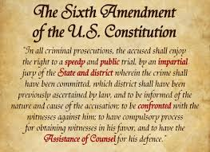
The 6th Amendment gives people accused of crimes important rights. It says you have the right to a fair and speedy trial by a jury of your peers. You also have the right to know what you're accused of, to have a lawyer, and to question witnesses who are against you.
Notes:
https://www.newyorkappellatelawyer.com/blog/sixth-amendment-effective-assistance-counsel/

Slide 6
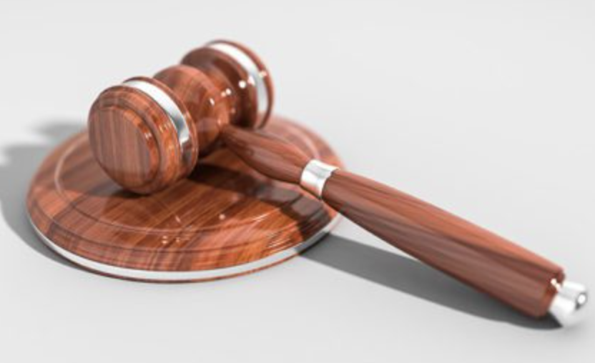
Due Process Clause
guarantees procedural due process for an indigent person to have the right to court-appointed counsel in all criminal cases before they may deprive a person of a protected life, liberty, or property interest.

Slide 7
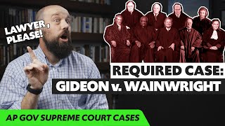

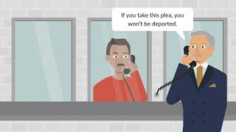

Gideon v. Wainwright
Strickland v. Washington
Padilla vs. Kentucky
Missouri vs. Frye

Slide 8
As a group, you will complete the case study chart for Strickland v. Washington. For this case, you will work as a class and complete the chart together. Do not move onto the following cases until the class has reviewed the model case. Remember, the 2 prong test is based on 1) Was there deficient performance and 2) Was there prejudice. If there is a NO for either, there is clear evidence of ineffective counsel!

Slide 9
Landmark Case Study: Strickland vs Washington 1984
Strickland v. Washington | 466 U.S. 668 (1984) | Justia U.S. Supreme Court Center
Stickland v Washington pdf.pdf
Strickland v. Washington | Oyez
David Washington faced trial in Florida for a series of very serious crimes including murder, kidnapping, and assault. He chose to plead guilty to all charges, which meant the court moved directly to the sentencing phase of the trial. His lawyer did little to investigate or present mitigating evidence. He sentences to death. Washington later appealed due to the fact that his right to effective counsel was violated.
Set a precedent called the “Strickland Test” for determining when a lawyer offers ineffective counsel.

Slide 10
Strickland Test
Prong 1: Deficient Performance
The defendant must show that their lawyer’s conduct was unreasonable. They must have shown that they were below the standards of a competent attorney.
Examples:
  Failing to investigate key evidence or witnesses
  Not preparing for trial or cross-examination
  Ignoring obvious legal defenses
  Advising a guilt pleas without reviewing the case properly
Prong 2: Prejudice
The defendant must also show that the lawyer’s poor performance harmed the outcome of the case. Specifically, there must be a “reasonable probability” that the result would have been different if the lawyer had done their job properly.
  The error must have mattered - must have affected the verdict, sentence, or plea.

Slide 11
Student Case Studies:
Gideon v. Wainwright, Missouri v. Frye, & Padilla v. Kentucky
Directions: With your group you will be assigned a Court Case to study.
Links and Resources:
Missouri v. Frye Expert Group
Missouri v. Frye | Oyez
Missouri v. Frye | 566 U.S. 134 (2012) | Justia U.S. Supreme Court Center
Missouri v. Frye Pdf.pdf
Links and Resources:
Padilla v. Kentucky Expert Group
Padilla v. Kentucky | Oyez
Padilla v. Kentucky | 559 U.S. 356 (2010) | Justia U.S. Supreme Court Center
Padilla v. Kentucky pdf.pdf
Links and Resources:
Gideon vs Wainwright Expert Group
Gideon v. Wainwright | Oyez
Facts and Case Summary - Gideon v. Wainwright
Gideon v. Wainwright pdf.pdf

Slide 12
Debrief
Persistent Issue: What should society do to promote fairness and justice for people who live within its jurisdiction?
Central Question: Who is entitled to effective counsel?
Where was ineffective counsel present?
Were these people fairly represented?
What were some of the opinions of the court?
How did the cases you examined build off the findings of the cases we unpacked together?
Did the Supreme Court get these cases right? Why/Why not?

