Slide 1




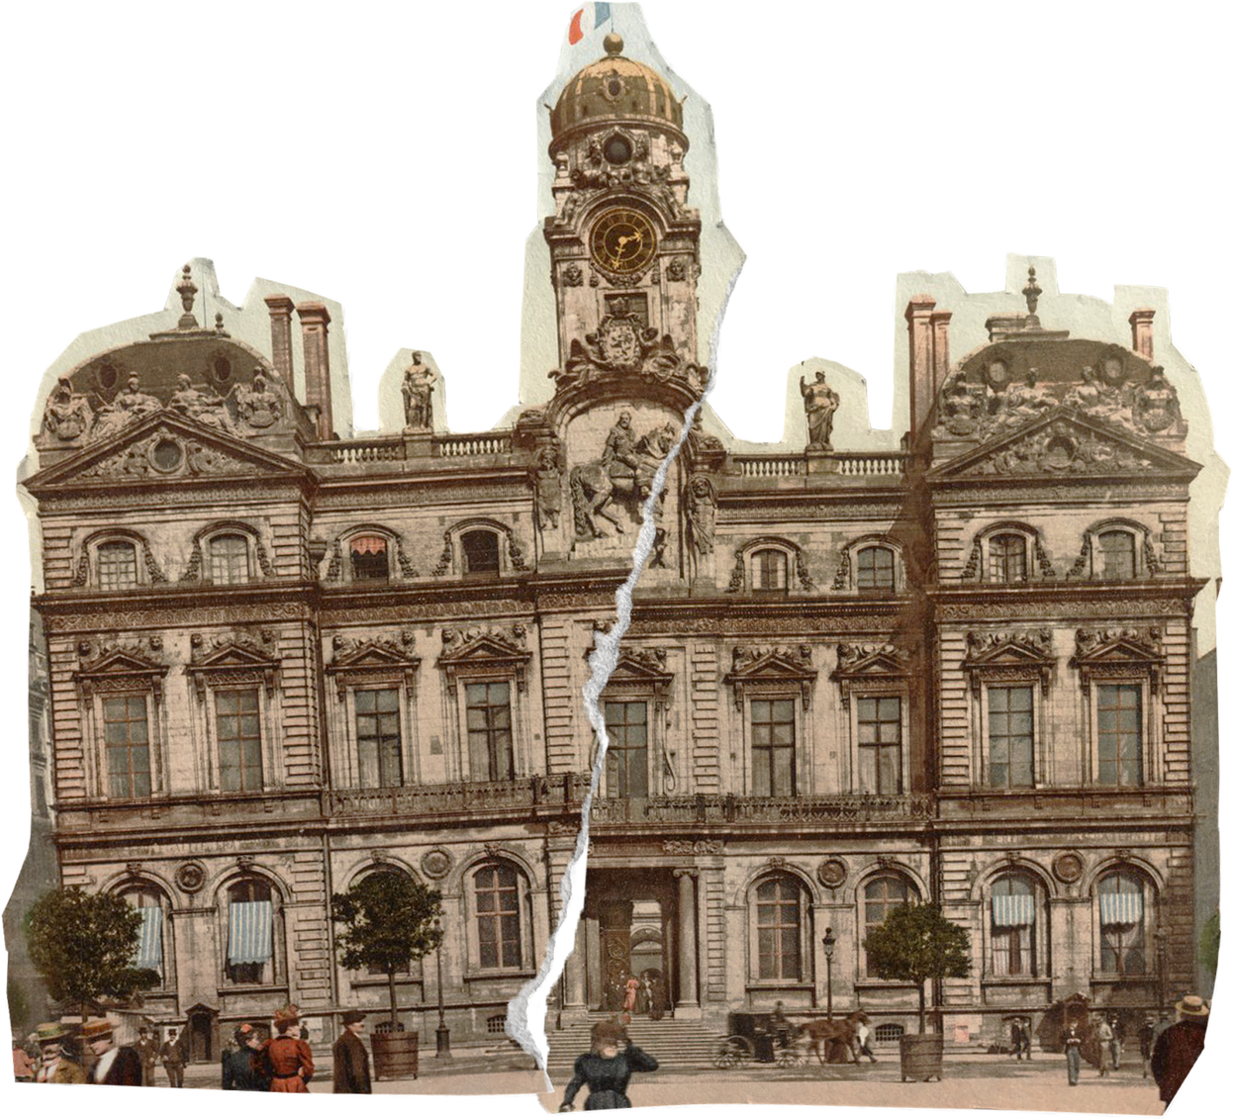
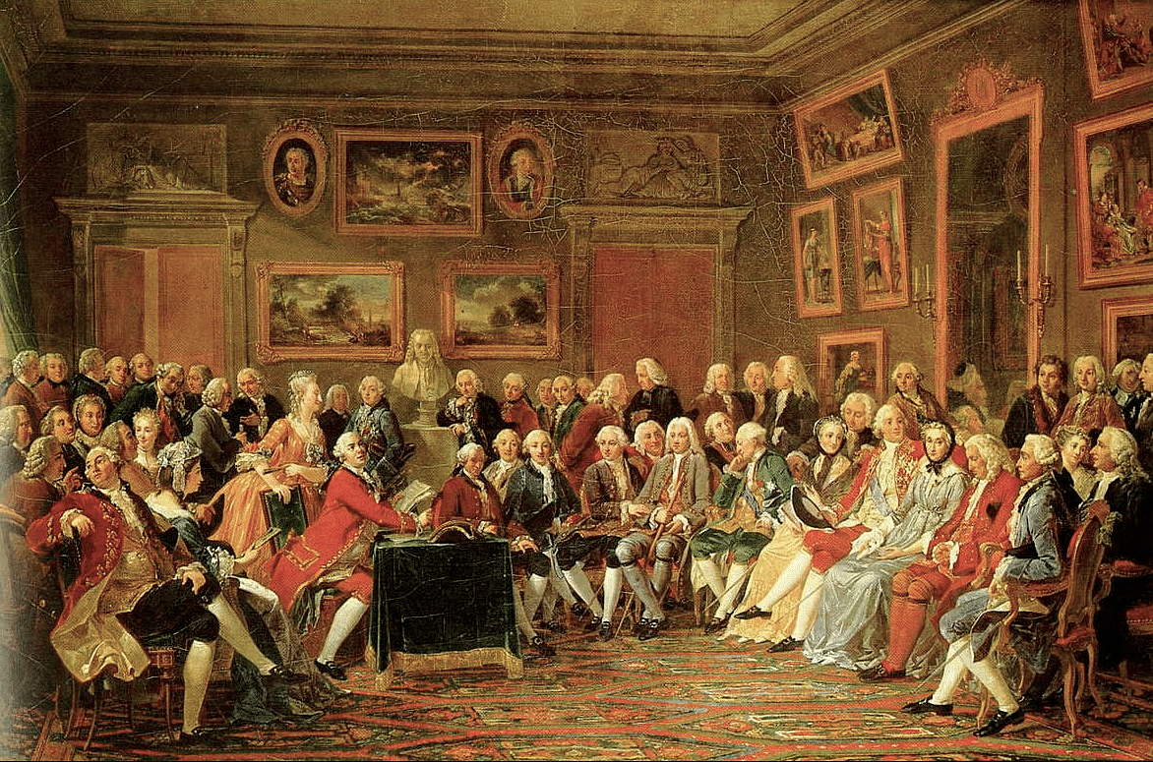

C.L.E.A.R. Thinking Project 2025-2026
The Enlightenment: A Salon Experience

Slide 2



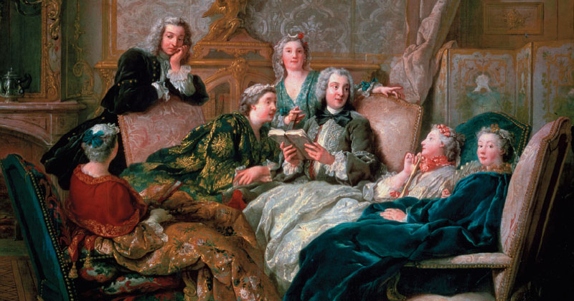
Persistent Issue: What should society do to promote fairness and justice for people who live within its jurisdiction?
Central Question: What is just treatment for those accused of a crime?

Slide 3


Appetizer:
3-Course
Dinner Schedule
Dabble in an assigned philosophical perspective based on Enlightened philosopher, coupled with a guided scaffold to ensure understanding.
Entrées
Experience a hand crafted gallery walk of evidence that boasts notes of clarity.
Dessert
Share a robust conversation with other philosophers, in true salon fashion; finished with a glaze of open discussion and voting.

Slide 4

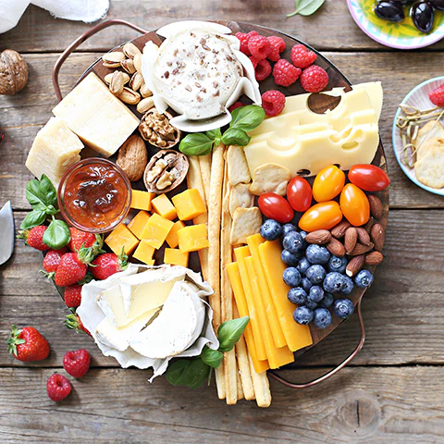



Course
1
Appetizers: Establishing Your Perspective

Slide 5
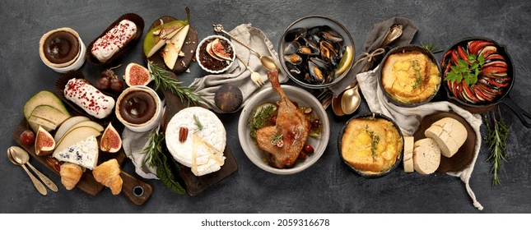
Course
2
Entrées: Evidentiary Gallery Walk

Slide 6


Slide 7

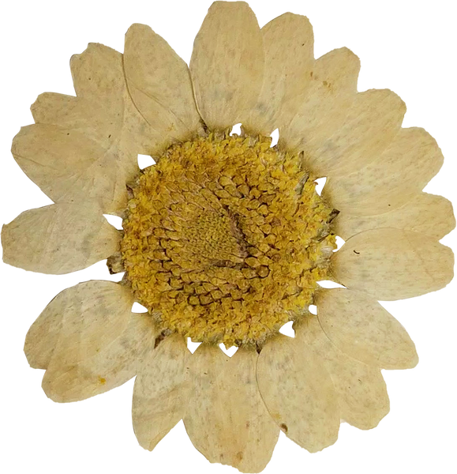

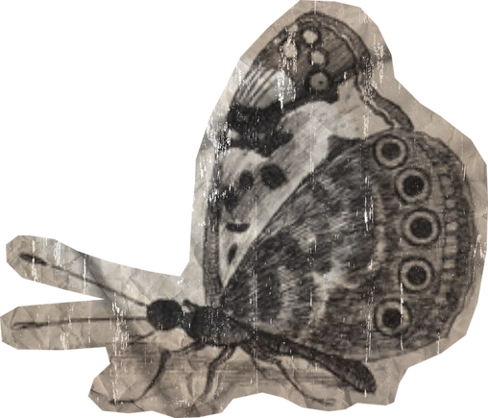
Complete the top portion of the chart with your group, prior to the small group Dessert activity.

Slide 8
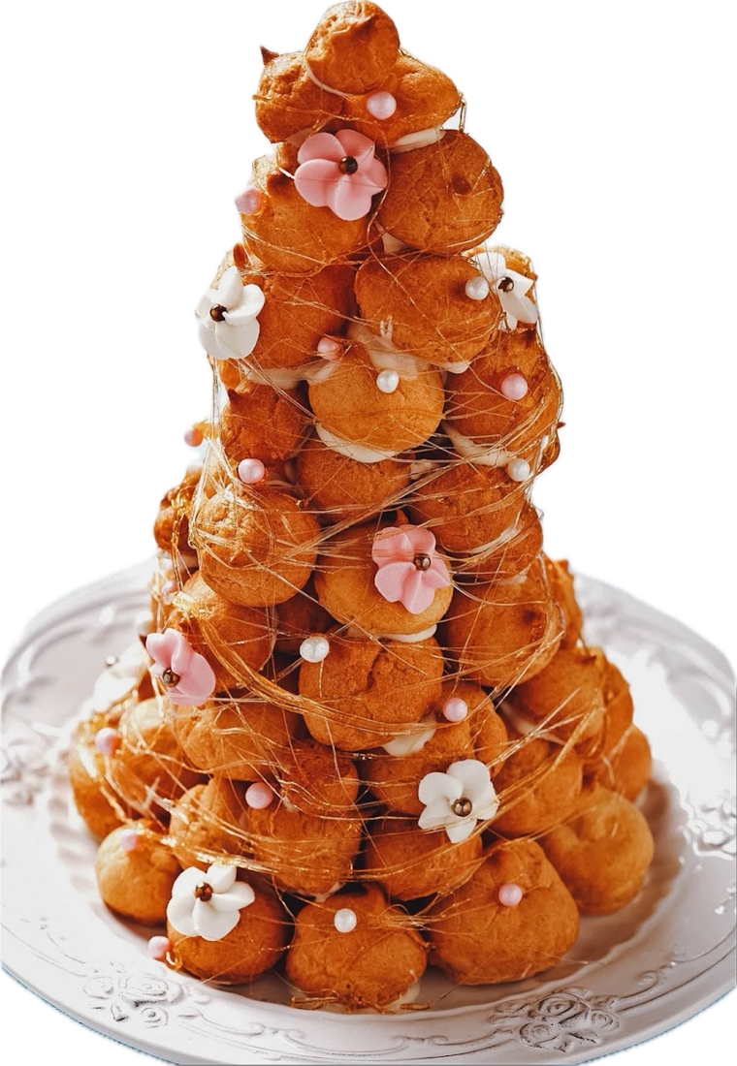
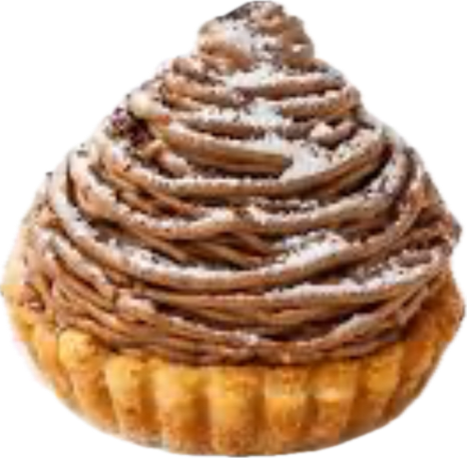

Course
3
Dessert: Small Group Think Allowed

Slide 9



SHARE
Each student takes a turn to share their responses.
After each student shares, other students in the group are given a chance to as questions.
Dessert Directions:
OPEN DISCUSSION
Openly discuss your opinions and conclusions

Slide 10

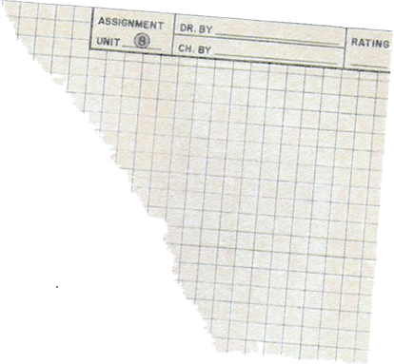

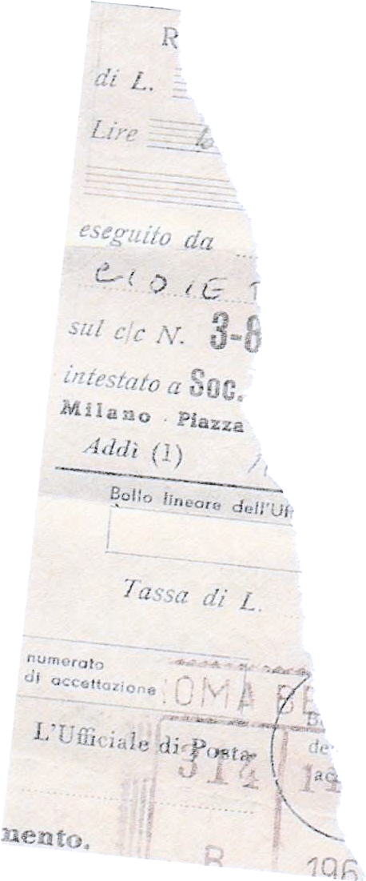













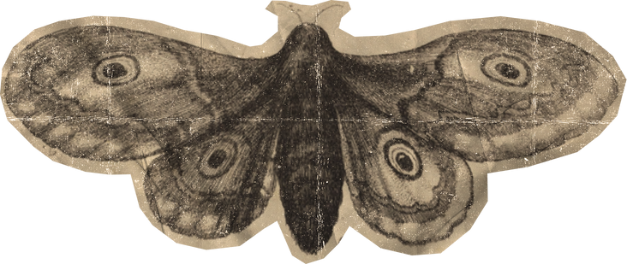




Just or Unjust?

Slide 11
Guilty or Innocent?

Slide 12
Great work today!

