Slide 1
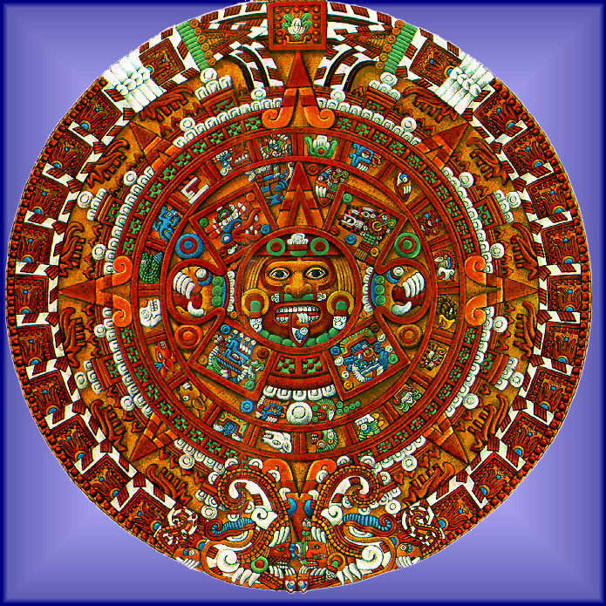
AZTEC WAR COUNSEL
Image Source:
León-Portilla, Miguel. Aztec Thought and Culture. Vol. 67, The Civilization of the American Indian Series, University of Oklahoma Press, 1963.
https://www.oupress.com/9780806122953/aztec-thought-and-culture/Access Date July 18th, 2024.

Slide 2
C.L.E.A.R. Thinking Project
Persistent Issue: What actions are justified in the interest of the welfare or security of the community?
Central Question: “Should the mesoamericans unite in war against the Spaniards?”

Slide 3
Speech Requirements
DIRECTIONS: After reviewing the documents provided to your group, you must discuss your stance with your group and come to a consensus as to how your group will vote in the war counsel. Before taking a vote, each group will give a brief speech on their perspective of the issue.
Content
Briefly summarize your group (name, values, geography, important details)
Fully addresses the question
Clearly answers the question
Uses strong evidence from documents to support claim
Speaker presents the information confidently, in a convincing manner.
Length
Speech must be 2-4 minutes in length
Cannot exceed 4 minutes

Slide 4
Slide Requirements
DIRECTIONS: Your group must create a slide in our shared Google Slides as part of the presentation. Please review the details below.
Content
Your native group name
Your stance/claim/answer
3 strong reasons to support your claim
Well organized
Visually appealing
Original Image
Must be an original, student-generated image to represent your group, your values and point of view.
**You have creative freedom to make your slide colorful and unique.**

Slide 5
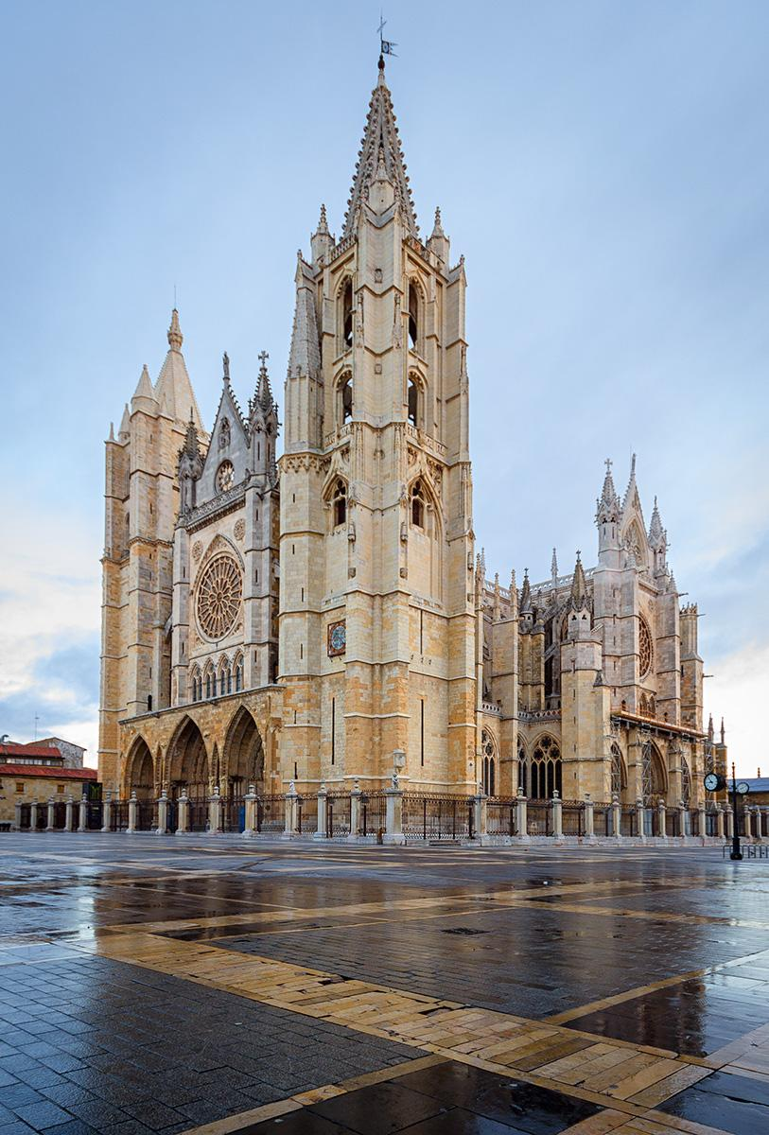
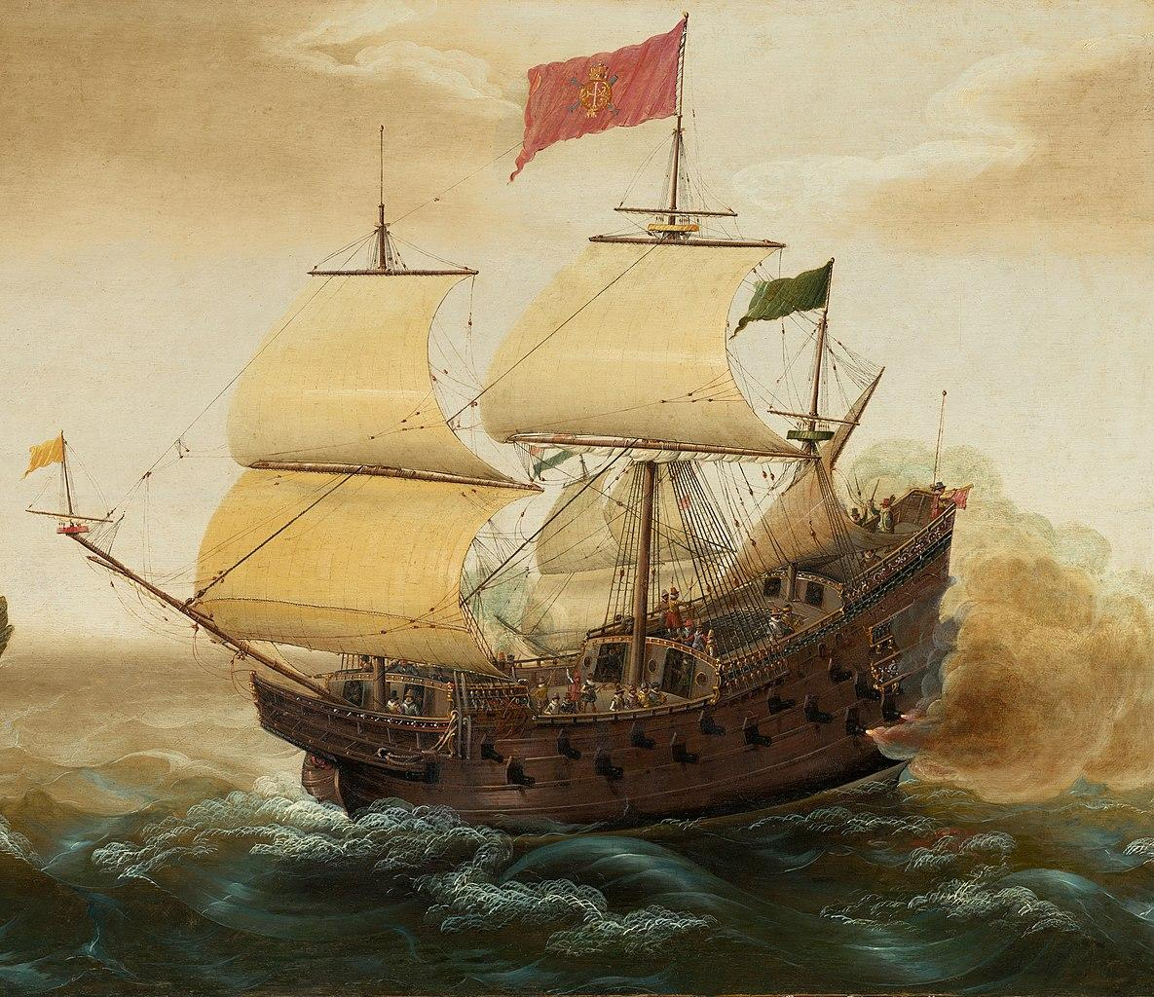
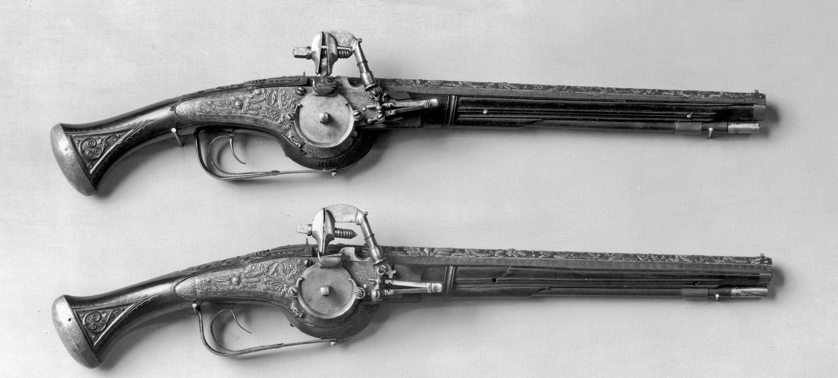
The Spaniards
*These must be hand-drawn in student submissions
The Mesoamericans should NOT unite against the Spaniards because…
We will never sacrifice humans for religion.
We bring advanced technology and a scientific understanding of the world.
We represent a massive empire across the great ocean. We would offer you safety if you join us.
OVERTHROW MOCTEZUMA!!!
JOIN SPAIN!!!

Slide 6
Great job!

