Slide 1
Read together as a class: The Racial Divide in the United States in 1967: A Vote for the Future of the Movement
© PIH Network 2025

Slide 2
Issues SNCC Must Vote On In 1968…
Inclusion
Advocating for racial integration and cooperation with white allies.
MLK Jr.
March on Washington
SCLC
SNCC
Freedom Rides
Exclusion
Focusing on Black self-determination and limiting white involvement
-building strong, independent institutions, sometimes separate from white society, to ensure empowerment.
Black Panther Party
Malcolm X
V.
© PIH Network 2025

Slide 3
Issues SNCC Must Vote On…
Non-Violent Resistance
Focuses on peaceful protests, legal challenges, and cooperation with allies to achieve social change.
MLK Jr.
March on Washington
SNCC
Sit ins
Freedoms Rides
Self-Defense/Violent Tactics
Focus on addressing economic inequality, poverty, unemployment, and creating wealth within Black communities.
Black Panther Party
Malcolm X
V.
© PIH Network 2025

Slide 4
Issues SNCC Must Vote On…
Political
Focus on achieving political equality, voting rights, and equal representation through legal and legislative means.
Civil Rights Act 1964
Voting Rights Act 1965
Economic
Emphasizes the right to protect oneself and one’s community, sometimes through more militant or violent methods when facing systemic violence and oppression.
Black Power Movement (1960s-1970s): Emphasized economic independence, self-reliance, and creating Black-owned businesses to combat systemic economic barriers.
V.
© PIH Network 2025

Slide 5
SNCC Convention Examples
© PIH Network 2025

Slide 6
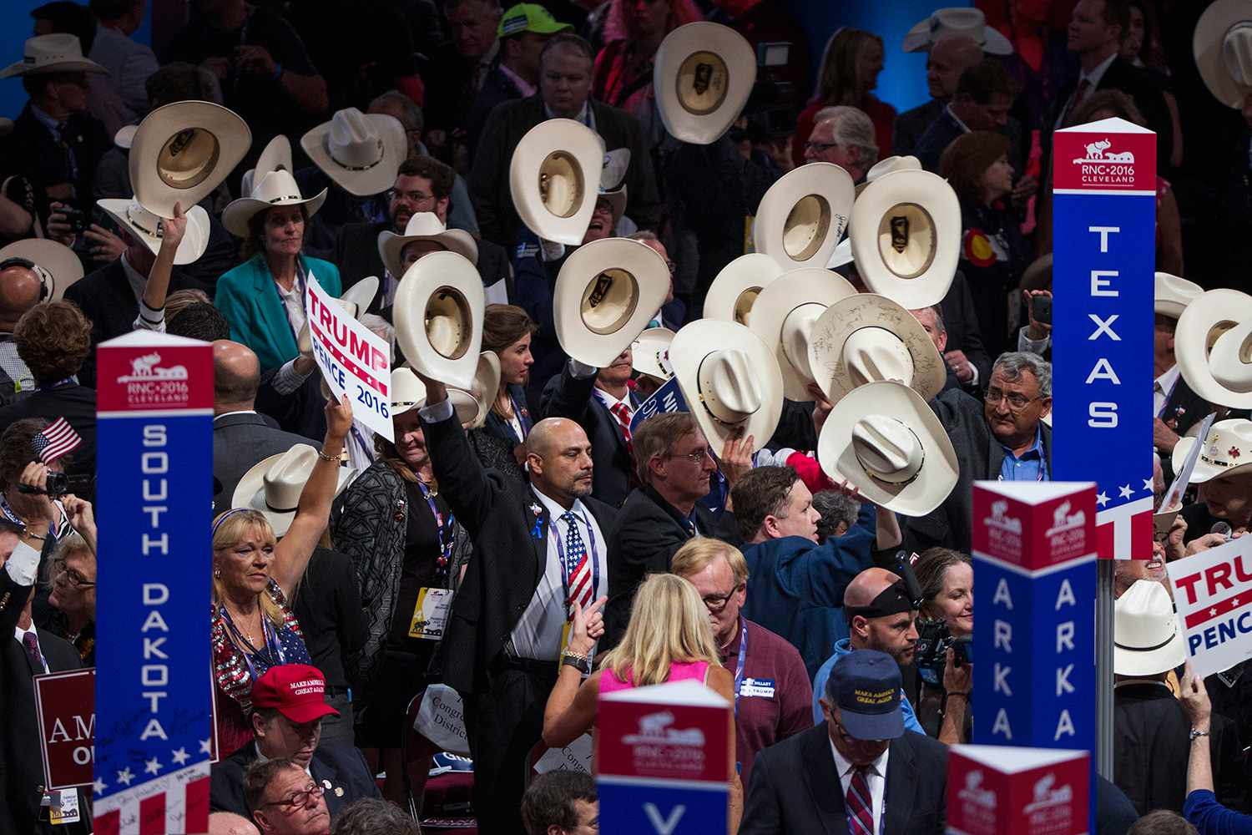
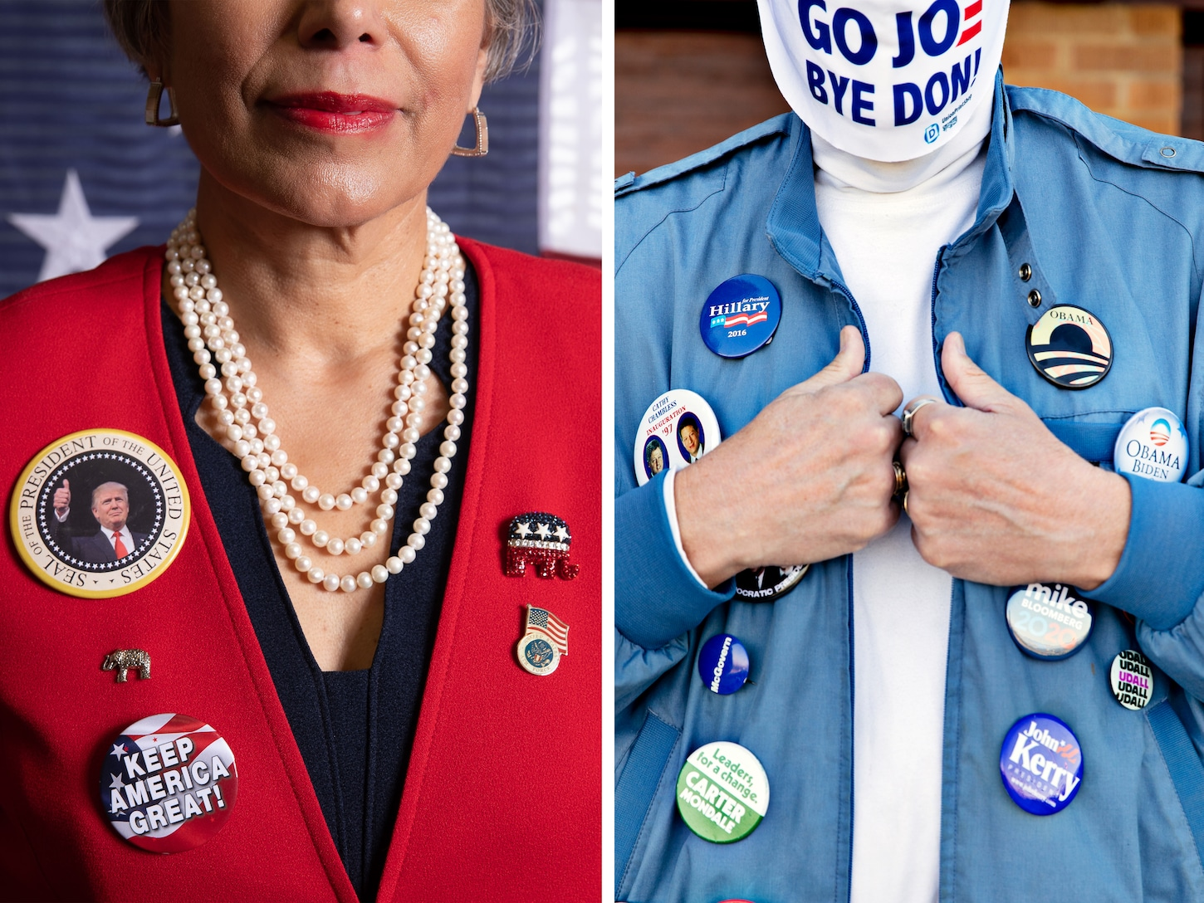
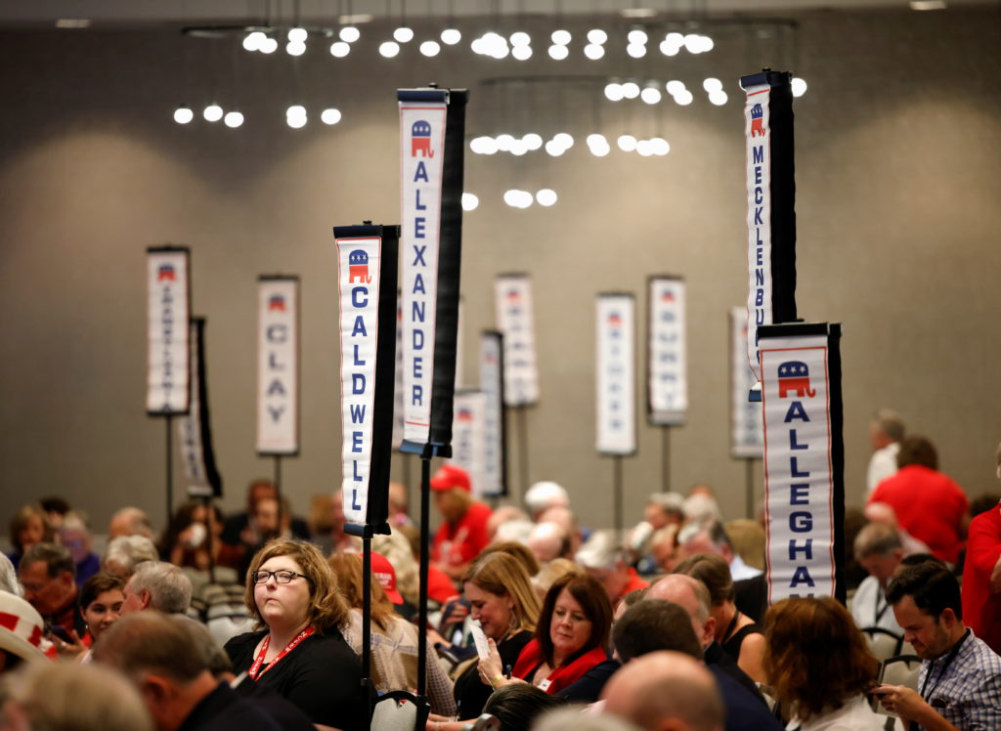
© PIH Network 2025

Slide 7
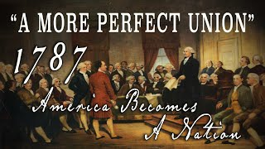
© PIH Network 2025

