Slide 1
Continental Congress
Georgia Delegation
We are the delegation from the American Colony of Georgia, and we plan to sign the Declaration of Independence at the Second Meeting of the Continental Congress
Group Members: Jane, Josh, Joe, and Jessie
Notes:
NOTES FOR SPEECH:
We are the delegation from the American Colony of Georgia, and we plan to sign the Declaration of Independence at the second meeting of the Continental Congress.. Georgians have traditionally been loyal to the crown. However, because the problems with the British have gotten so much worse, we feel like we can no longer support the crown.
Today, we will be explaining to you why the colonists of Georgia, who we represent, feel like we must declare our independence from Great Britain.

Slide 2
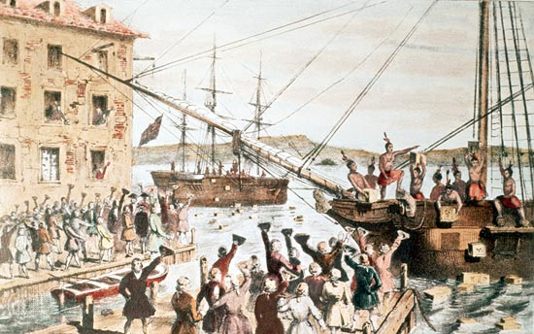
“No taxation without representation!”
- Patriot slogan
We think that if people have to pay taxes, they should have a say in their government.
Notes:
NOTES FOR SPEECH
We think that if people have to pay taxes, they should have a say in their government. The king has raised our taxes many times. This makes buying goods from England very expensive. However, we still don’t have any representation in Parliament.
We have tried to find a solution, or compromise over this situation. Instead of compromising, the British have continued to raise our taxes.
As the popular Patriot slogan goes, “No taxation without representation!” We are no longer willing to pay these high taxes to a government in which we have no active part.

Slide 3
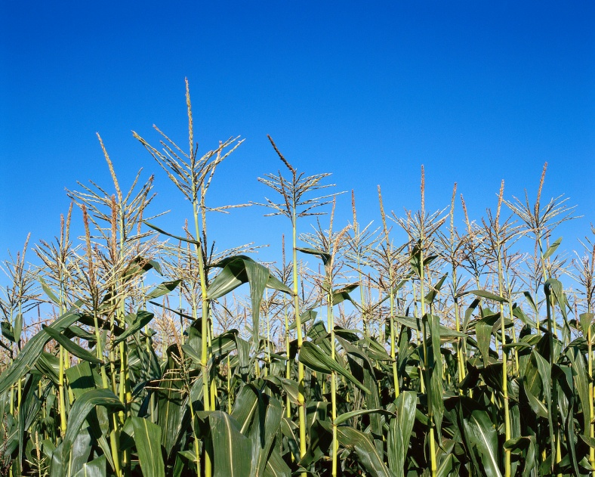
Mercantilism
We believe that the British system of mercantilism hurts colonial farmers.
“It is so far true of England, that the same tyranny which drove the first emigrants from home, pursues their descendants still.” - Thomas Paine
Notes:
NOTES FOR SPEECH:
The British system of mercantilism hurts colonial farmers.
Colonial farmers are forced to sell their goods at low prices to the British. If they were free to do so, colonial farmers could probably get much higher prices for their goods from the French, or traders from other nations. Farmers should be allowed to sell their goods for a fair price to whoever they want to sell to. Colonial farmers would make more money this way.
Georgia has many farmers. So, this is a major issue for our colony. Our farmers could expand their farms and improve their situation if they could sell their goods to who they wanted to, at a fair price.
Thomas Paine said, in his pamphlet, Common Sense, “It is so far true of England, that the same tyranny which drove the first immigrants from home, pursues their descendants still.”
What this means is that the British are still treating the people in the colonies the same bad ways that made those people want to leave Great Britain in the first place. So, unless we declare independence, nothing is going to change.

Slide 4
British treatment of Colonists
We are concerned that the unfair British treatment of the colonists in Massachusetts will spread to other colonies
Examples: the quartering of soldiers, searches of homes, and the closing of Boston Harbor.
“Give me liberty or give me death!” – Patrick Henry
Notes:
NOTES FOR SPEECH:
Our third major concern is the way that the British are treating the colonists in other places, mainly Massachusetts. We are afraid that this harsh treatment will eventually spread to other colonies, including Georgia.
We feel like these things are intolerable:
The Quartering of Soldiers.: This allows British soldiers to live in somebody’s house, uninvited, for as long as they want. Our homes belong to us, not to the British.
Searching people’s homes: The British are searching people’s homes without having a reason to do so. This is terrorizing the citizens of Boston and other places.
The closing of Boston Harbor: This act closed one of our busiest port cities in the colonies. This will hurt the economy of all colonies.
We feel like these rules, known as the “Intolerable Acts,” are something that the colonies can no longer live with. So, to borrow the words of Patrick Henry, “Give me liberty, or give me death!”

Slide 5
Opponent’s Position:
Our opponents might say:
- Patriots are violent traitors who terrorize law abiding people.
- Declaring independence will lead to war.
We say:
The English laws are unjust, and we have a right not to follow them.
We have tried many times to work and compromise with King George. He has left us no other choice.
Notes:
NOTES FOR SPEECH:
Our opponents might tell you that patriots are violent traitors who terrorize law abiding people. Well, we say that the British laws have become completely unjust, and we have the right to refuse to obey them.
Our opponents might tell you that declaring independence will lead to war. This may be true, but we say that we have tried every peaceful way to compromise with King George. We have tried to find a peaceful solution, but the British have left us no choice but to declare independence.

Slide 6
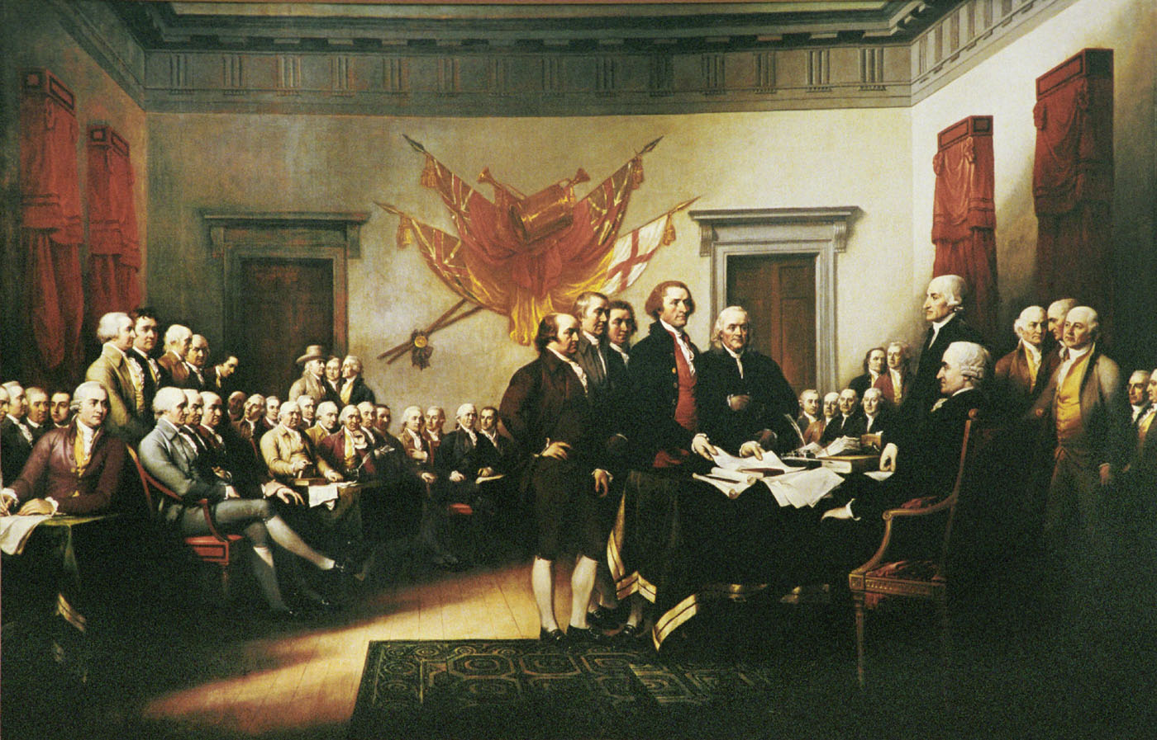
We want independence from the British because:
We should not be taxed without a chance to represent ourselves in Parliament.
British mercantilism hurts colonial farmers.
We won’t accept the harsh treatment by the British.
Notes:
NOTES FOR SPEECH:
In conclusion, I would like to go over our three reasons to declare independence from Great Britain:
“no taxation without representation”
English mercantilism hurts colonial farmers.
We won’t accept the Intolerable rules and harsh treatment by the British any more.
The delegates from the colony of Georgia will be signing the Declaration of Independence.

