Slide 1
Afrikansans Solution
Separate but Equal
Presented by:

Slide 2
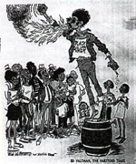
Different Groups Have tried Different Tactics
Legal Challenges
Civil Disobedience
Separation from Whites
We are More Divided
than Ever
What will work best in
the future to create an equal
America?
Support Links:

Slide 3
GOAL: CREATION OF A SEPARATE BLACK STATE
STRATEGIES:
* Lobby Congress to Pass
Constitutional Amendment
Creating Afrikansas: an All-Black
51st State
* Massive Nation-Wide Boycotts
of All Stores
Media Campaign Urging Business to Pressure Congress to Act
Support Links:
INSERT
VIDEO CLIP
HERE

Slide 4
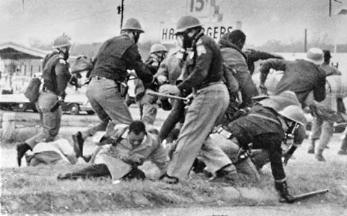
Arguments for the Strategy
Requires An Independent
Economic & Political Power
Base
* Blacks Lack Enough Economic
Clout to Influence Political Leaders
* When Owners Suffer Economic
Losses, Will Pressure Congress
* Sympathetic Media Coverage Will Sway Public Opinion
Support Links:

Slide 5
Arguments Against Strategy
Separate is not equal
Boycotting and lobbying
processes are slow
1968 is not 1963
Tensions may make things worse
Support Links:

