Slide 1
What Really Happened?

Slide 2
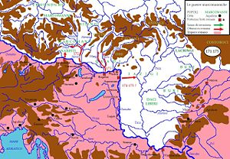
Roman Offensive 171-175
Notes:
MA’s decision is to go on the offensive and extend out the Roman border.
This is similar to MA’s strategy in the Parthean War and in North Africa.
MA wants to create 2 new provinces from these German groups.

Slide 3
Cassius the Hero
Cassius was a war hero from the Parthian War
Cassius burned the capital city Seleucia to the ground
172 – uprising along the Nile River in Egypt
Avidius Cassius was brought in to put down the rebellion

Slide 4
Cassius’s Betrayal
172 – Cassius named the governor of Egypt
175 – He is told that Marcus Aurelius is dead
Cassius chooses to believe the rumors and names himself Emperor of Rome
Marcus Aurelius comes to Egypt prepared to fight a civil war

Slide 5
Cassius’s Betrayal
Cassius is then killed by 2 officers that find out Marcus Aurelius is alive and on the way
When Marcus Aurelius arrives he regrets no opportunity to pardon Cassius
Executes Cassius’s son and main advisor
Chooses not to read documents that lead to further investigations
Returns to Marcomannic War
Notes:
Burns the letters to further investigation and further killings
Faustina dies along the way back from Egypt

Slide 6
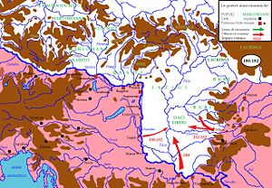
Marcomannic Wars
Notes:
The goal now is to push the Germanic Tribes back to the Carpathian Mountains. (Brown)
The Danube is not a sufficient boarder.
Pros – Mountains better defense, Client status is not working and Roman provinces are necessary
Cons – Getting up the Carpathian Mountains is costly and now the Roman Empire has more land to monitor and keep in check; even more enemies to the North passed the Carpathian Mountains

Slide 7
Marcus’s Vision
Prior to Marcus’s Death, he attempts to form two new provinces in German tribal areas
He then stations 20,000 troops among the Marcomanni and Quadi to watch their every move
Puts in place additional measures to ensure the stability of the area
Notes:
Renegotiating client relationships with tribes with the intent of using one group to monitor and stabilize another
A condition for renegotiating client status was giving back Roman prisoners, Barbarian prisoners captured by Romans would be sold into slavery
Germanic Tribes had to often pay tributes at different rates according to how well they favored
Marcus gave privileges to favored groups that cooperated during the earlier military campaigns
Some groups were granted passage out of Roman territory and into neighboring German areas to conduct marriage ceremonies and religious rituals (Tribes had long standing networks among German people – Romans realized they violated these German networks and tried to appease groups when ever possible)
No large group were allowed to remain together inside the empire and client groups were not allowed to assemble freely
Exclusive trading privileges to the Romans and only utilizing Roman transportation

Slide 8
Marcus Aurelius’s Death
In 180 Marcus dies in Vindobona along with his vision of the Northern Front
Commodus assumes control of the Roman Empire
Commodus did not pursue his father’s vision for the North
German tribes represented a continuing threat to the Roman Empire
Notes:
German Tribes would eventually start invading again towards the end of the Roman Empire
Eventually Rome is forced to give up much of their gained land. Leaders, believing that they were over extended, eventually pulled back to deal with other issues facing the empire.

