Slide 1
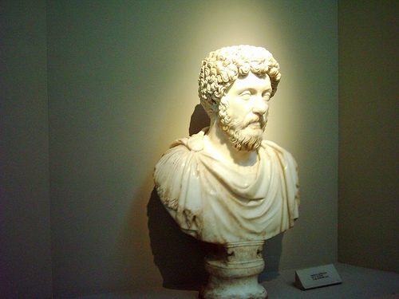
Marcus Aurelius Think Aloud Introduction
What should Marcus Aurelius do to preserve the Roman Empire?

Slide 2
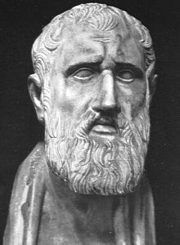
What is Stoicism?
A school of thought that flourished in Greece and Rome. It was founded by the Greek philosopher Zeno.
Stoics believe that one’s goal in life is to live a life of great moral worth and free of conflict and strife.

Slide 3
Basic Tenants of Stoicism
The following are basic tenants of Stoicism:
Do ones duty
Look to the highest power of reason (Think before you act!)
Pursue a good life based on rational thinking
Pleasure or pain will not overpower you
Accept good and bad events (We cannot understand the significance of the events because of our limited way of thinking!)

Slide 4
Meditations
Think continually how many physicians are dead after raising their eyebrows over the sick . . .and how many philosophers after endless conversation on death or immortality. . Always remember how temporary and worthless human being are. . Pass through this little space of time comfortably to nature and end your journey in content, just as an olive falls off when it is ripe . . .
How does this statement coincide with the Stoic belief that one should accept both good and bad events?

Slide 5
Stoic Beliefs on Human Nature
All human beings are rational.
Rational thinking requires education and exercise.
All human beings are brothers.
The Roman Empire is the best example of a rational society.

Slide 6
Stoicism and Foreign Policy
How might Marcus Aurelius’ stoic beliefs influence his view and treatment of groups surrounding the Roman Empire?
Discuss in your groups how you think Marcus Aurelius will treat Rome’s neighbors.

Slide 7
Problems of the Roman Empire
The Roman Empire experienced many problems during Marcus Aurelius’ reign.
Military
Immigration
Bureaucracy
Economy

Slide 8
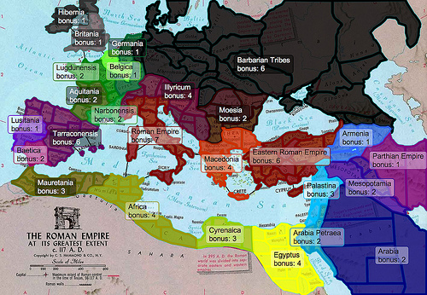
Battles on the Border
Aurelius is fighting northern invaders at the Danube River
Parthian province is being invaded by Persians into Armenia
Aurelius has legions fighting in Mauretania (North Africa)
Aurelius must decide where to focus legions

Slide 9
Parthian War
Parthians are encroaching on Roman lands
163 Aurelius sends co-emperor Verus to lead the battle
Roman territory is expanded further into the Persian lands.
Verus dies 169

Slide 10
Effects of Parthian War
Cassius becomes popular in eastern provinces as a winner
Eastern provinces joke that Aurelius is a “philosopher woman”
Legions return to Northern Border. Rebellions continue along the Roman borders.
Legions bring plague back with them
Decimates military and civilian populations

Slide 11
Northern Borders
German tribesmen, “barbarians”, began to pour across the Danube - 166
Germans wanted the better farmland under Roman control

Slide 12
Roman Reaction in North
170 1st offensive unsuccessful
Germans seized Roman ports along the Adriatic Sea.
Tribes penetrated most of the Balkan peninsula, Eleusis – very close to Athens
171 begin to push Germanic tribes back – regain Raetia and Noricum
172 solid victory over Marcomanni – trapped on Danube

Slide 13
What would you advise….?
You are a military advisor to Marcus Aurelius. What would you advise Marcus Aurelius to do about the barbarian invasions in the north?
Discuss 2 -3 options in your groups that you would suggest to Marcus Aurelius.

Slide 14
Immigration
Many Germanic tribes moved south because of the pressure they felt from other tribes, who were pushing southward toward the Roman empire.
Plague wiped out many of the farmers of Rome, which left open, farmable land.
Many immigrants were brought to work the land for the Romans and not given legal status.
Many immigrants were hired as mercenaries.
Some officials criticized the policy.

Slide 15
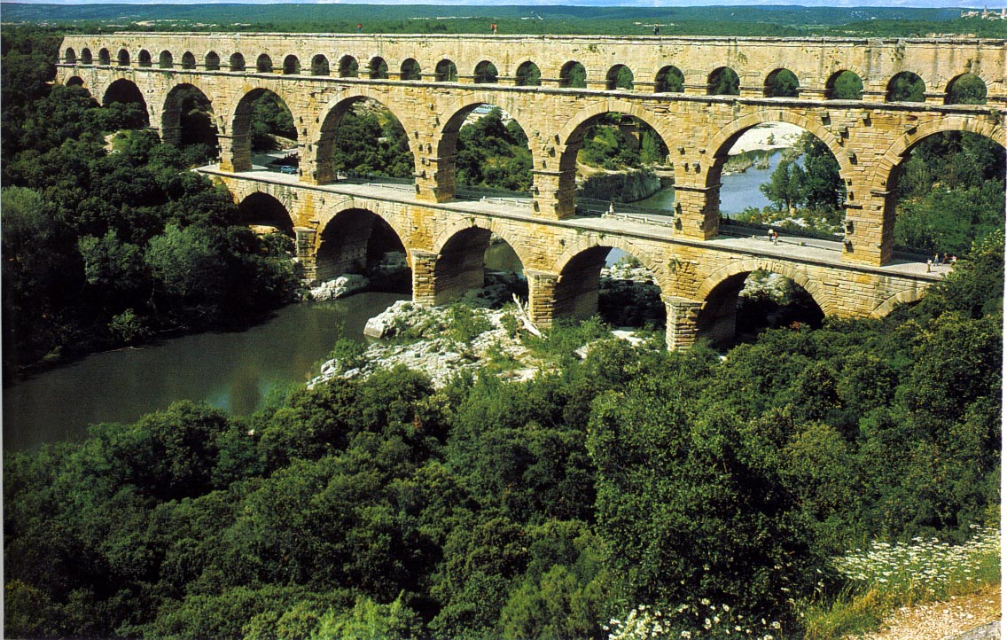
Bureaucracy
People working for the Roman government: governors, tax collectors, judges, soldiers, messengers, and engineers.
The size of the Roman Empire made communication and regulation of government agencies complicated.

Slide 16
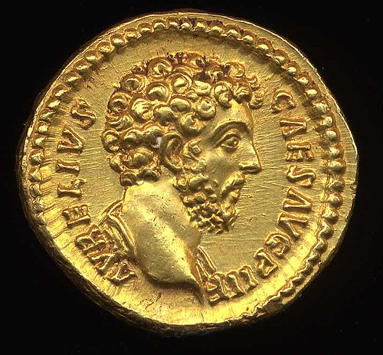
Economy
The economy of the western portion of the empire has never been fully developed.
Eastern cities become wealthy and powerful.
Due to the decreasing gold supply, inflation becomes a huge problem.
Increasing military costs are adding to the problems of the crumbling economy.
Notes:
As eastern cities become more powerful, the western cities lose power. ( Rome becoming less powerful and Alexandria becomes known as the second city.)

Slide 17
Marcus Aurelius’ Reaction to the Economy
169 - Imperial property was auctioned to pay for the costly wars.
He lowered the fee for a Senate seat to make it more affordable for the less wealthy.
Public assistance for hospitals, free burial due to the plague, and orphanages.

Slide 18
What would you advise. . . . ?
You are political advisors for Marcus Aurelius. What would you advise him to do about immigration? Keep in mind the bureaucratic and economic issues.
Discuss the plan you would propose.

Slide 19
What actions should Marcus Aurelius take to preserve the empire?
The year is A.D. 172. You and your Roman legions have just won a decisive battle in the north. You have driven the Marcomanni back across the Danube.
What should you do to preserve the empire?

