Slide 1
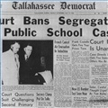
CQ: What was the best way to stop discrimination in Alabama during the 1950s and 1960s?
Lesson Focus Question: Was passing new laws or going to court an effective way to stop discrimination?
Notes:
Remind students of overall unit question. Tell students that today they will look at one strategy used by civil rights activists to end discrimination – the Legal Strategy. Remind students of the lesson question for today and how today’s lesson will help students answer the Unit CQ.

Slide 2
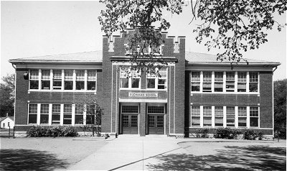
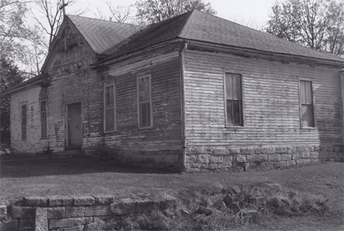
Comparing Schools
School for whites School for blacks
Notes:
In their small groups or as a class, ask students to compare and contrast the two images. Have students consider the what they see on the outside of the building but also what might be on the inside. Encourage lots of ideas and conversation.
Next, transition to the “Linda Brown Incident” by explaining that students will briefly learn about one family who was unhappy with the differences in the schools. Read the Linda Brown Incident or have students read it individually.

Slide 3
Read Linda Brown Incident
Questions to Consider & Discuss:
What problems is Linda facing?
Why was Linda not allowed to attend Sumner Elementary School?
Do you think it was fair that Linda was not allowed to attend Sumner Elementary School?
Do you think the government should become involved? Why or Why not?
Explain how you would feel if you were not allowed to attend your neighborhood school because of your race?
Notes:
Once students have read the reading, use the questions on the slide to dig deeper into the reading and the background of the Brown vs. Board of Education case. Encourage lots of conversation. Probe students’ thinking.
Before moving on, make sure that the students understand why civil rights activists believed something needed to be done to end discrimination in schools. Conclude by pointing out that in the case of school segregation, civil rights activists decided to go to the courts to try to bring about change.

Slide 4
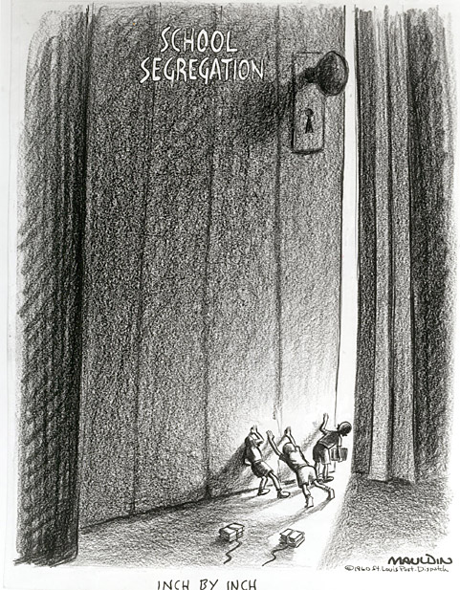
What are Laws
Laws are rules that tell you what you can and cannot do in a society. If you break them, you can be punished.
What laws do we have today?
Why do you think these laws were created?
Notes:
Explain the definition of laws to students.
Next use the following questions to get students thinking about laws and why we have them.
1) What laws do we have today? – speed limit, stealing, murder, alcohol/ tobacco, discrimination (handicapped, immigrant)
2) Why do you think these laws were created?- we initially had a problem; that’s why laws come about
3) Is it ok to try to get a law changed if you think it is not fair?

Slide 5
WHAT IS COURT?
Courts of law are the umpires of the American legal system.
Decides if law was broken.
Decides who is right when one person “sues” another.
Decides on punishment.
The U.S. court system is divided into two separate systems, the federal and the state.
U.S. Supreme Court
Federal Courts
State Courts
Notes:
Explain to students why we have courts and what they do in American society. [Be sure to define the word umpire. Compare them to a baseball or football game.] Make sure that the students understand that there are different levels of court and that a court’s decision can be appealed (asked to be changed) all the way up until the U.S. Supreme Court.
Court is a place where a problem is solved with the help of a judge and a group of citizens chosen to hear the case (ex. Judge, Jury..)
Courts are supposed to apply and interpret the law.
Two types of cases are taken to court: civil and criminal.
Civil cases usually deal with disagreements about people's rights and duties toward one another. (ex. divorce, custody)
Criminal cases are brought by the government (either state or federal) because a law has been broken.

Slide 6
What is a legal strategy?
A method of bringing about change through the courts.
Courts can throw out bad laws and make people do the right thing even if they don’t want to.
Notes:
Remind students that the civil rights activists decided to use the LEGAL STRATEGY to try to end segregation in public schools. This meant that they went to the courts to try to get segregation laws changed. Sometimes this meant that they had to “sue” a board of education or the superintendent of a school system. Other times this meant that they defended black children accused of breaking segregation laws. Explain that the civil rights activists knew that the state courts in the south would probably not agree with them. What they decided to do was to appeal the cases to the FEDERAL courts because they thought they might win there.
Discuss students’ initial thinking about the legal strategy: Is a legal Strategy the best way to “get something done”?
After discussion, tell students that to answer the question well, they first must have a little bit of background on an important case (Plessey vs. Ferguson) as well as a group of back people (NAACP) who came together to try to use the courts to end discrimination in schools.

Slide 7
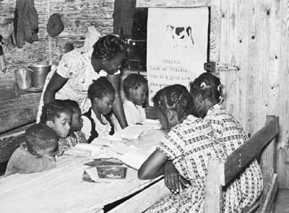
Plessy v. Ferguson (1896)
The U.S. Supreme Court decided a law mandating separate but equal accommodations for blacks and whites was constitutional.
Notes:
Explain that in 1896, many years after the end of slavery, the U.S. Supreme Court decided that a Louisiana law mandating separate but equal accommodations for blacks and whites on railroads was legal & constitutional. This decision made it ok for state and local governments to separate blacks and whites. This decision resulted in the “separate but equal” idea. In other words, the court said that it was ok for blacks and whites to be separated in public places as long as those places were equal.
Explain that the Brown vs. Board of Education case in 1954 will be about whether the decision in the Plessy case was right.
Note: The teacher may need to do independent research on the Plessey case in order to explain it well.

Slide 8
Civil Rights Activist Group
Notes:
Explain that many organizations were formed to help fight for African Americans to have equal rights. One organization that played a major part in fighting segregation in schools was the NAACP: National Association for the Advancement of Colored People.
The NAACP was the main group that organized the Brown vs. Board of Education case on behalf of black people. It paid lawyers to fight the segregated schools in the federal courts.
The National Association for the Advancement of Colored People, usually abbreviated as NAACP, is an African-American civil rights organization formed in 1909. Its mission is "to ensure the political, educational, social, and economic equality of rights of all persons and to eliminate racial hatred and racial discrimination.”

Slide 9
Brown vs. Board of Education
Notes:
Show the brief video clip of Linda Brown trying to gain admission to the all white school.
After the clip, explain that when Linda was denied admission into the school, Linda's father, Oliver Brown, challenged Kansas's school segregation laws in the Supreme Court. Topeka's NAACP branch helped Mr. Brown to challenge the segregation law. The NAACP argued that separating Black children from White children could never truly be equal.
The Supreme Court, under Chief Justice Earl Warren, announced its decision in the case of Brown v. Board of Education of Topeka, Kansas on May 17, 1954. The decision declared that the system of segregated public schools in the United States was unconstitutional, wrong, and unfair. A unanimous Court ruled that "separate" was inherently unequal which meant that separating people based on their race could never be equal. In their decision, the judges said that segregation made black children feel inferior to white children. The court’s decision overruled the decision in the 1896 Plessey vs. Ferguson case.
After the ruling, many black people “sued” school systems that chose to ignore the U.S. Supreme Court. By suing, black people hoped to get the courts to make segregated schools integrate. Explain to students that during the rest of the lesson they will look at a fictional school and be asked to decide if and when the school should be integrated.

Slide 10
Response Group Activity 1
Situation: Pool Middle School was the school all students wanted to attend. It was a large, beautiful and had all the best school features. This school was originally all white but now since the Brown vs. Board of Education case integrating this school has become an issue. Different viewpoints about integration were expressed to a reporter for a local newspaper in 1965 about integrating African American students with white students.
As you read each viewpoint consider who is arguing each viewpoint and which argument you agree with. Think about how when each person wants integration to happen.
White Parent
Administrator (Principal)
Black Student
NAACP activist
Notes:
If they are not already, be sure that students are placed in small groups before beginning. Explain to students that the purpose of Response Group 1 is for students to understand that not everyone agreed on integrating the schools or on WHEN it should be done. Student groups will be asked to decide which viewpoint or perspective they agree with and why. They will also be asked to explain how they would use the courts to end segregation in schools.
Provide students with the three Response Group Activity 1 Handouts. Allow student groups to work through the viewpoints. As students work through the viewpoints, the teacher should use the “Teacher Guide” to help and probe group thinking. Be sure students are identifying “when” each viewpoint wants integration to occur.
READ the “Situation” from the slide to the students and review the directions for thinking about the viewpoints. Release students to work in their groups.
When student groups get to the final two questions, remind students to think about the “Things to Consider” bullets at the top of the sheet. Those bullets should help students think about their decision.

Slide 11
Response Group 1 Debriefing
Each person you read about had a different view on WHEN desegregation should happen. Which one did you agree with? Explain.
How would you use the courts to END segregation? Explain what you would do and how long it should take to integrate the schools.
Notes:
Once all groups have completed the handouts and answered the questions on the third page in their groups, lead a whole class discussion about the groups’ decisions for each question. Each group should have one student identified as the spokesperson. The teacher should poll the groups to get a feel for class opinion regarding the question of integrating Pool Middle School. Then, the spokespersons are called on to defend their choice. All group’s may not have a chance to share during this response group debrief. This will depend on the size of the class and the time available. The teacher will play "devil’s advocate" as necessary to challenge student’s thinking and present an authentic view of the dilemmas associated with integrating a school that had been segregated for years. After the discussion, tell students that they will now look at a few historical examples of how the court order in the Brown vs. Board of Education case was actually implemented.

Slide 12
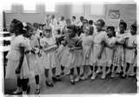
Successful Integration?
Do you think that the Brown vs. Board of Education decision was carried out peacefully anywhere?
Notes:
Have the students briefly speculate about whether some schools were able to integrate their schools without any violence.

Slide 13
Examples in which the legal system worked slowly Little Rock Nine Ole Miss University of Alabama
Notes:
Explain to students that resistance by whites leaders, threats of violence, and actual physical violence often slowed integration down.

Slide 14
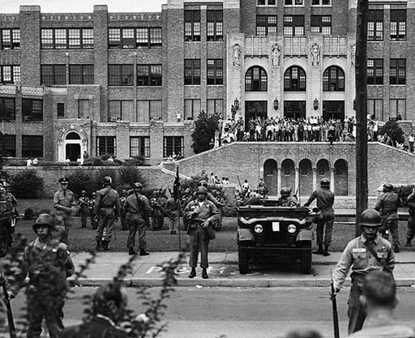
Central High School 1957
9 African American students try to enter Central High School in 1957 to begin to desegregate the school. Violence and protest erupted!
Notes:
Central High school in Little Rock Arkansas was a prominent case in the story of school desegregation. Once the order came from the federal government (President Eisenhower) to desegregate, chaos erupted. Once Eisenhower heard about the chaos in Little, he ordered the National Guard to come and try to create order. 9 African American students were the first students to pave the road to desegregation. They entered the school with troops serving as their guards.
Because things went “wrong” at Central High the media covered it. Situations where it went right the media did not cover as in depth.

Slide 15
Elizabeth Eckford
Elizabeth Eckford, a young black girl who was part of the Little Rock Nine, walks alone while being insulted as she enters Central High School
Notes:
Elizabeth Eckford, pictured in the front, was a part of the Little Rock Nine. Eckford was alone when she got off the bus a block from the school. A mob at the school quickly surrounded her and began shouting at her. The Little Rock Nine were supposed attend school together, but their meeting place was changed the night before to go in through the back of the school in the hopes of avoiding violence. The Eckfords had no telephone so she was not informed. When she tried to enter the campus twice, she was turned away both times by the National Guard.

Slide 16
James Meredith
James, Meredith, a young college student, walks down the steps at Ole Miss (U. of Mississippi) while being guarded by federal troops and U.S. Marshals.
Notes:
Meredith sent a letter to the registrar of The University of Mississippi requesting an application for admission. When officials learned from Meredith that he was African-American, his application was immediately rejected
Meredith began his pursuit for admission in January 1961, after watching the John F. Kennedy’s inaugural speech. President John F. Kennedy ordered United States Marshals to protect Meredith. During the riots by whites, cars were burned, federal marshals were hit with rocks and bricks, and university property was damaged. The harassment became so intense that Meredith only spent two semesters at Ole Miss but he had opened the university to future black students.

Slide 17
Autherine Lucy
Autherine Lucy being accompanied with Thurgood Marshall, Authur Shores and the NAACP marching to settle her expulsion from the University of Alabama
Notes:
Lucy request for an application to the University of Alabama. After being accepted, she paid a dormitory registration fee of five dollars. When the university found that she was black they immediately offered her money back. Black attorney and desegregationist Arthur Shores wrote to the university president requesting that the young lady be admitted to the University. The President would not agree to admit Lucy , so Shores and Thurgood Marshall of the NAACP Legal Defense Fund took the matter to court. Lucy enrolled as the first black student at the University of Alabama. Lucy was chased from campus only three days after her arrival. A month later she was expelled from the university because the university said they could not protect her. Lucy was readmitted to the university later in life and received a Masters degree from Alabama in 1992.

Slide 18
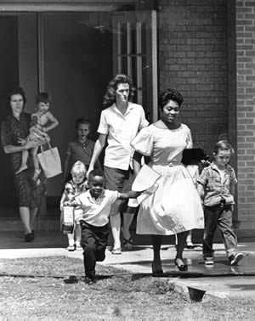
Successful Integration
Fayetteville, Arkansas
1954
Notes:
Explain to students that in some cases, integration happened quickly and with little violence and that one such example was in Fayetteville, Arkansas.

Slide 19
Within a week following Brown v. Board, Fayetteville announced its intention to desegregate.
Three months later, white and black students were attending the same local high school together.
Although there was a fear that violence might happen, nothing serious was ever reported.
Notes:
Explain that violent acts were more likely to be reported to the media. There were some peaceful integrations that weren’t reported on by the media so we don’t often hear about these cases.
Transition to the final Response Group by telling students that they will now evaluate the overall LEGAL Strategy.

Slide 20
Response Group 2
Directions: 1) Complete the chart with your group. Focus on the legal strategy. 2) Listen to your teacher when the chart is reviewed.
Reasons TO USE the Legal Strategy to Stop Discrimination | Reasons NOT TO USE the Legal Strategy to Stop Discrimination
Notes:
Response Group 2: The second response group activity focuses on the change strategy of using the legal system. Students evaluate the effectiveness of using the courts to desegregate schools. Distribute the Response Group 2 handout to student groups. Read the introductory paragraph to students and then release the groups to complete the chart. Note that it may be necessary to assist the class in completing the chart if they struggle to complete it on their own. Use the chart in the slide and the Teacher’s Guide to help students complete it if necessary.
Once students have the chart completed, direct groups to discuss final the two questions with their group members. In their groups, they brainstorm ways the strategy worked and limitations of the strategy. Then, as a group, they form a conclusion about the strategy as a whole. To conclude the lesson, the teacher should debriefs the second response group activity in the same manner as earlier in the lesson. Students should then complete a final individual assessment to ensure they understand the legal strategy before moving on to consider nonviolence/direct action.

