Slide 1
Topic 7:
Impact of “civilization” policy of Washington and Jefferson
on Creek Indians
Establishing Foundational Knowledge and Empathy:
Empathetic Role Play

Slide 2
Establishing Foundational Knowledge
Empathetic Role Play
Topic: “Civilization” policy of Washington and Jefferson and Creek Indians
Central Question: Will “civilization” lead to our general welfare?

Slide 3
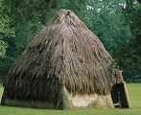
Creek Culture
Family: Matrilineal Structure
Compound:
Matriarch/husband
Unmarried children
Married daughters/husbands & children
Land owned by woman’s family

Slide 4
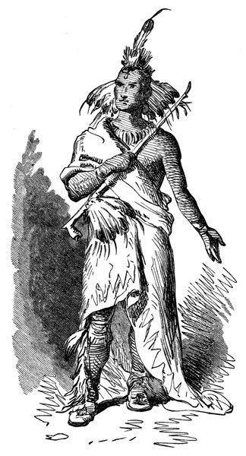
Gender Roles
Men:
Council
Hunting
Warfare
Communal buildings
Women:
Farming
Children/elderly
Cook
Domestic tools

Slide 5
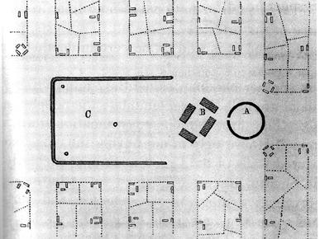
Land/Town
Land owned by village
Council divides land for clans
Towns surrounded communal cropland and hunting land
A – winter/hot house
B – town square
C – ball court

Slide 6
Government
Council meeting mornings
Mico – chief – speaks for village
No enforcement power
Talk until consensus

Slide 7
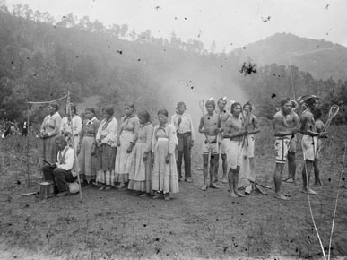
Religion
Great Creator
Spirits of universe

Slide 8
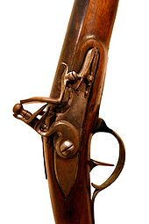
Trade
Commercial hunting
Deerskins for blankets, guns, ammunition, cloth
Spanish, French, English, then United States
Need to maintain hunting lands
Deer population diminishing

Slide 9
Historical Dilemma
Central Question: Will “civilization” promote our general welfare?
Council Meeting:
Read the letter outlining the “civilization” policy President Washington is proposing and fill in right side of chart – if we do what he proposes, how will our culture change?
Prepare questions you want to ask Washington’s representative, Benjamin Hawkins when he comes talk with our confederation.

Slide 10
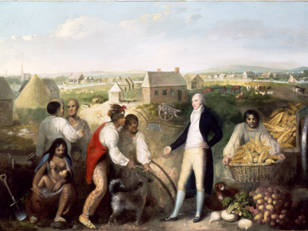
Hawkins and the Creeks

Slide 11
Historical Dilemma
Central Question: Will “civilization” promote our general welfare?
Confederation Meeting:
What are the potential benefits of this policy for our people?
What are the potential damages for our way of life?

Slide 12
Persuasive Billboard
Central Question: Will “civilization” promote our general welfare?
Make a persuasive billboard either supporting or rejecting President Washington’s “civilization” policy. Convince us what to do.

Slide 13
PIH Curriculum Design Principles
Scaffolded Instruction
Authenticity
Multiple Intelligences
Effective Collaboration
Notes:
Most prominent in this strategy are #2 and #3 – tried to make the basic questions facing the continental congress personal and relevant to students – empathy
Multiple intelligences – video, visual, text, watching peers get up to be interviewed, etc. Also, multiple perspectives on the important questions.

