Slide 1
Topic 6a:
Interactive Slide Lecture
Establishing Foundational Knowledge
Progressive Reforms

Slide 2
Lesson Focus Question:
How should reformers address inequities existing in American society at the turn of the 20th century?

Slide 3
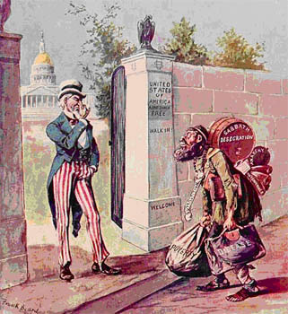
Source: http://webpages.ull.es/users/jcruz/textos1/progressive1.htm
Notes:
Discussion Questions: Instructor asks a series of questions to frame the Americanization debate among Progressives.
What do you see? What can you read that might help us interpret the cartoon? [Instructor will help audience read anything not visible.]
What makes Uncle Sam nervous?
What do immigrants need to be successful in America?
What does American society need from immigrants? What does America need them to do? [Our focus for next section.]
In the 1890s, new immigrants from Italy, Eastern Europe, and China came to America to fill jobs requiring unskilled labor that emerged following the mechanization of industry. English and Germans often filled skilled positions. Irish controlled lower positions of medium skill. At the bottom were the unskilled laborers from these new locales. For many of these groups, there was no social net except that provided by unions, fraternal organizations, or the city machines / bosses. We will look at this relationship a little later in the lecture.

Slide 4
WHAT SHOULD BE REQUIRED OF IMMIGRANTS TO BE GOOD DEMOCRATIC CITIZENS?
Notes:
Rhetorical Sub-questions: Should we accept immigrants as they are and fight for that acceptance or help them become like people already living in America? Which is more realistic? Which is more helpful to our republic? To them?

Slide 5
We have learned to say that the [common] good must be extended to all of society before it can be held secure by any one person or class; but we have not yet learned to add to that statement, that unless all [people] and all classes contribute to a good, we cannot even be sure that it is worth having.
Jane Addams, “Educational Methods”, Democracy & Social Ethics
Notes:
Discussion Questions:
Who was Jane Addams?
What is she most remembered for?
What does she believe about democracy?
What does Jane Addams think is needed for immigrants to become democratic citizens? [Possible response: If society provides skills and knowledge to assimilate poor and needy immigrant children into American culture, they can rise from squalor and become productive citizens.]
Content: Big picture, Addams believed that action to bring about social change would only result from the education and engagement of the masses, including the most recent of immigrants. Settlement houses, Hull House being the one she’s famous for, fulfilled this educational role in industrial society and thereby provided a basis for maintaining democracy among uneducated immigrants. Settlement houses offered immigrant families education and opportunities for self-development such that they could participate in public debate. Education was therefore the basis for transforming society for the better.

Slide 6
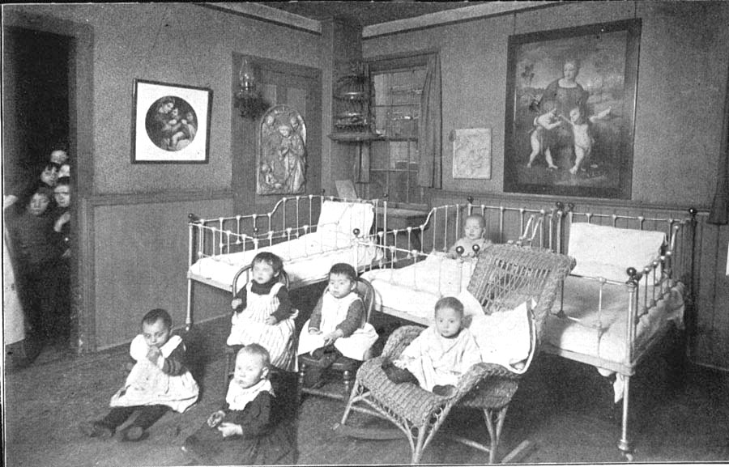
Unknown photographer. (1895). Hull-House Nursery.
Notes:
Discussion Questions:
What do you see in the photo?
What do you think is happening in the photo?
[Reveal that is is Hull House.] What might an immigrant gain from being a part of Hull House? What do Progressive reformers gain?
What is the overall message of the photo? How do you know this?
Content: Jane Addams founded Hull House in 1880 in Chicago. It provided social, educational, and artistic opportunities for children (orphans) and working class adults (mostly recent Eastern European immigrants). Volunteers taught classes in literature, history, art, domestic activities, held free concerts, and offered free lectures on current issues. Its facilities included a night school for adults; kindergarten classes; clubs for older children; a public kitchen; an art gallery; a coffeehouse; a gymnasium; a girls club; a swimming pool; a book bindery; a music school; a drama group; a library; and labor-related divisions. Hull-House was well known for its efforts to assimilate immigrants through collective social efforts. Addams viewed individualism as selfishness and described it as a threat to industrial society.
Transition:
While Addams certainly had compassion for immigrant workers and even made attempts to respect their culture and values, what might have been lost by immigrants participation settlement houses like Hull House? [Immigrants observed middle-class values and living standards which began to tear them away from their own people and culture.]

Slide 7
Rahel Golub (Henry Street Settlement, Manhattan):
I was hearing good English, I was reading and…I was quickly learning the ways of this country... But at home and in the shop life became harder and harder…. The rooms seemed smaller and dingier than they had been…and there was a general look of hopelessness over everything... I saw the years stretching ahead of me, always the same, and I wept bitterly. I had never been so aware of it all.
Source: A Fierce Discontent, p. 103
Notes:
Discussion Questions:
What “ways of this country” do you think Rahel was learning?
At the conclusion, what does she mean when she says, “I had never been so aware of it all”?
How did Henry Street change Rahel’s perspective? How did her experience impact relations with her family? Did she encounter pain or loss?
On balance, did Rahel’s experiences at Henry Street benefit her?
What are the societal impacts of these settlement houses? Are they good for democracy? [Use as transition to next section on protecting democracy in industrial capitalist age.]

Slide 8
HOW DO YOU PROTECT DEMOCRACY IN AN INDUSTRIAL-CAPITALIST AGE?
Notes:
Sub Questions to Consider:
How has the economy changed? [contrast with Jeffersonian ideal]
With regard to Corporations?
With regard to Factories?
With regard to Cities?
How might that change influence the democratic process? Who is this new democracy listening to and serving?

Slide 9
Machine Politics – Democratic?
Insert film clip from “Far and Away.”
Source: Far & Away (1992)
Notes:
Set Up / Context for Clip: On this slide we showed the scene from the movie “Far and Away” that has Joseph and Shannon meeting Mike Kelley in the boxing club and Mike Kelley meets with Joseph to get him “on the road to citizenship.”
Joseph and Shannon immigrants form Ireland (Shannon rich/Protestant, Joseph poor/Catholic). Shannon pays Joseph’s way to America for his guardianship. When they arrive in harbor, man who Shannon felt was helping her is shot and she discovers he had stolen her silver spoons. She is left with no money. What are they to do? A boy tells them he can take them to the ward boss – who is the ward boss and how can he help?
Show Clip.
Discussion Questions:
How does the system work?
Who is Mike Kelly?
What would he help Joseph and Shannon? What is in it for him?
How does the system benefit Joseph and Shannon?
To what extent is this form of politics democratic? Is Joseph’s voice included in political system?
In what ways is the ward boss increasing participation in the political process?
If the purpose of government is to serve the people, is this helping the immigrants?
Who is helped by this process?
How would the ward boss defend this form of political organization?

Slide 10
Richard Croker of
Tammany Hall:
“There is no denying the service which Tammany has rendered to the Republic. There is no such organization for taking hold of the untrained, friendless man and converting him into a citizen. Who else would do it if we did not? There is not a mugwump in the city who would shake hands with him.”
Source: Riordan, W.L. (1963). Plunkett of Tammany Hall New York: E.P. Dutton & Co., Inc., p. xix.
Notes:
Discussion Questions:
In what ways did machine politics serve democracy?
Who are mugwumps?
What is the immigrant lacking in terms of preparation for democratic life?
How did the ward boss get the immigrant and laborer’s voice incorporated into government?
What did they do with that power? Whom did they serve?
What criticisms emerged among Progressives of this political system?
Background:
Tammany Hall was the Political organization of the Democratic Party: provided patronage to immigrants and voters: e.g., coal, place to live, a job, speak for someone at a trial, help gain citizenship.
Voter owed his vote to the Ward Boss.
Ward Boss rounded up votes to deliver for the next person higher up the organization, in return for patronage – political position in the bureaucracy, a seat on a political board, a real estate deal, information on an investment, a business (boxing, a bar, etc.)
Patronage might include inside information on a pubic park, buy that piece of land, then sell it to the city.
Mugwump – established power elites from old, wealthy families – non-immigrants

Slide 11
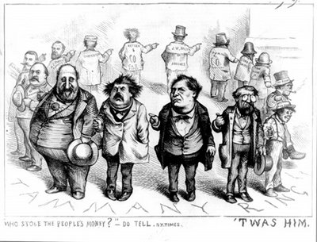
Machine Politics
Source: http://www.harpweek.com/09cartoon/BrowseByDateCartoon.asp?Month=August&Date=19
Notes:
Discussion Questions:
What do we see in this cartoon? Who is the large fat man in the bottom left? Who are the other men?
Why are they each pointing to each other?
What is the slogan?
What is the message of the cartoon?
Who does the cartoonist say the machine is serving? What did they do with their power?
The Times had obtained evidence that the Tweed Ring had pilfered the public's money in the form of inflated payments to government contractors, kickbacks to government officials, extortion, and other malfeasance. The estimated sum stolen was set at $6 million, but is today thought to have been between $30 and $200 million.
Cartoon was created by Thomas Nast and published in Harper’s Weekly in the fall of 1871. Tweed reportedly offered to send him on a European vacation. He said he did not mind the articles being written b/c his constituents could not read, but he had to do something about the “damned pictures.”

Slide 12
Criticism of Machine
“The big-city machines misused and abused, the immense power it won because its leaders could not envision a more just and more beautiful city than the mean and ugly neighborhoods in which they grew to manhood.”
Source: Lincoln Steffens, The Shame of the Cities, 1904.
Notes:
Discussion Questions:
What could the progressives do about this problem?
What about national politics? What was the situational at the national level?

Slide 13
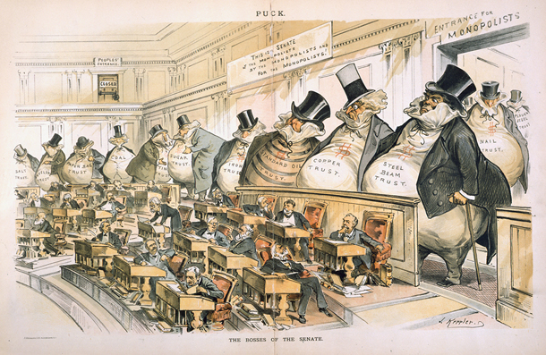
Trusts
Source: http://www.senate.gov/artandhistory/art/common/image/Ga_cartoon_38_00392.htm
Notes:
Questions to Guide Image Analysis:
What do you see?
What is the message of the cartoon?
What would be the remedy?
Break up monopolies?
Decrease their influence on politics?
Do corporations have a right to influence politics?
How do we balance that with the rights of laborers?
How could Progressives increase the political voice of the laborer?
Response Options to Consider:
Do Nothing – would lead to less competition
Socialism – would also lead to less competition
Anti-trust (break them up) – increase competition
Regulate
Tax them so they contribute to the public good
Discussion Questions to Begin Transition to Poverty:
How have average Americans been affected by industrialism (urbanization, factories, etc.)?
If we reformed these trusts, does that go far enough to address the problems of the typical American?
Let’s look at some issues of poverty in order to explore that question.
Transition Statement:
We’ve seen how the machine worked at the local level and how industrial capitalists influenced government to their own benefit. Let’s turn now to a couple of images that will help us consider whether progressive reformers went far enough – whether reform was needed that went beyond addressing trusts.

Slide 14
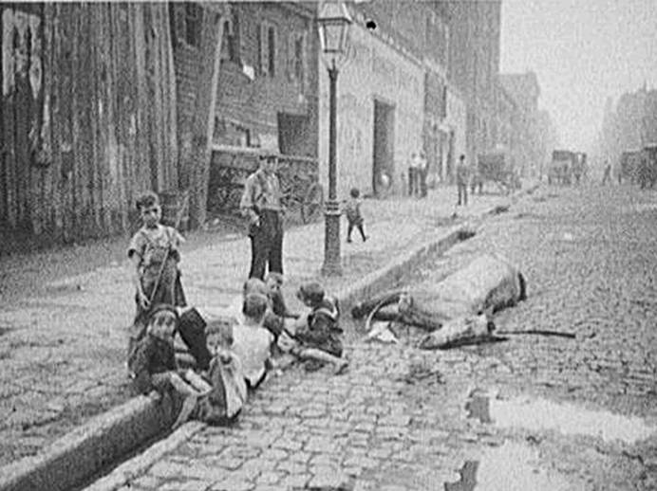
Poverty
Joeseph Byron. (1905). A Dead Horse.
Notes:
Discussion Questions:
What do you see in the photo?
What do you think is happening in the photo?
What is the overall message of the image? Why did the photographer take it?
What would need to be done to address the problems you see?
(Assuming responses include a number of sanitation reforms.): Is that enough? Would an average American reap the benefits of reforming the problems in this image? \
Are more fundamental changes needed to address problems of poverty?
If more fundamental changes are needed to address poverty, what could be done?”
Background Content: 9 kids play within a few feet of a dead horse, thought they don’t seem interested in it. The kids talk or play in a deep gutter that might be for runoff or sanitation. Two kids are wearing overalls or other simple clothes. One kid walks alone. Puddles are in the cobble stone road though it doesn’t look rainy. Run down wood walls to the left. The image seems to capture an ordinary day. Noone seems disturbed. The kids are playing in a gutter where sewer water or runoff flows away from the city. No one seems to be caring for the kids.
If the image does capture an ordinary day in NYC, life for immigrants and their children was filthy, dangerous, unpleasant, and probably short. By photographing this every day life image, Byron is likely making this problem of poverty known. Byron was a famous muckraking journalist who spent his life highlighting these problems. Jacob Riis is similar in this way.
The photo seems to refute the notion that the reformers were doing enough to solve problems of poverty. Byron and other reformers hoped to use imagery to focus public attention on the greed, neglect, and economic self-interest of the upper class wealthy elites. They argued that political talk was just empty rhetoric that only served to promote the interests of big-business industrial capitalists.
Without progressive intervention, the immigrant population, particularly children, would be left to suffer and die in filthy conditions. Progressive reformers must do more to protect and provide for the poor and needy. The image is a call to act – citizens have to do more to ensure that progressive reforms actually reach those who need it most.

Slide 15
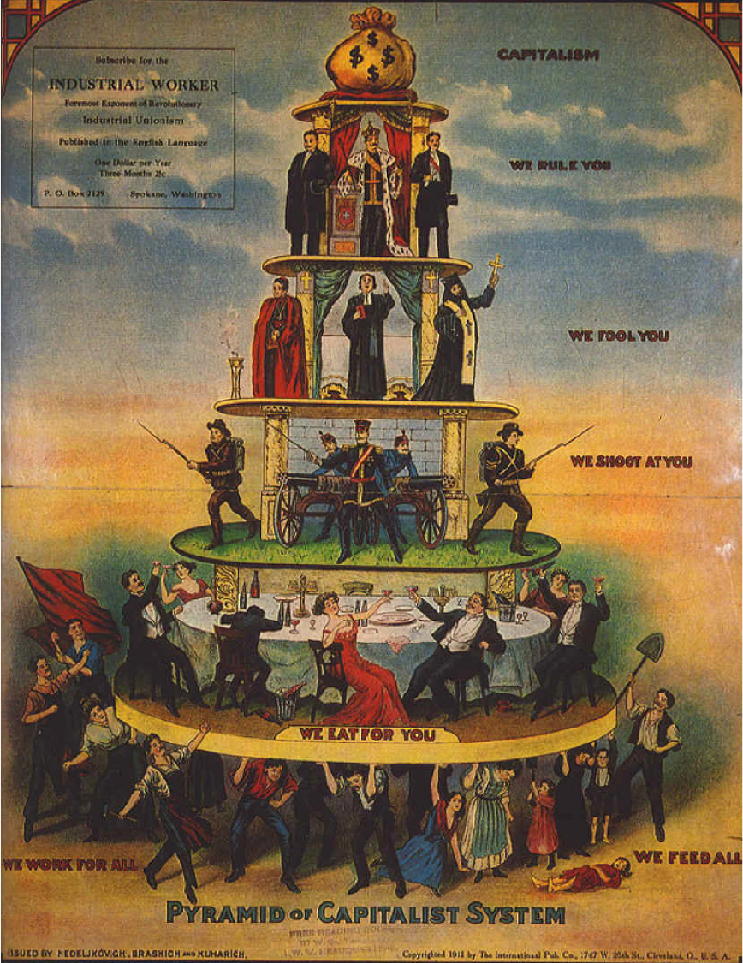
Source: http://en.wikipedia.org/wiki/Industrial_Worker
Notes:
Image: Promotional poster printed in the Industrial Workers of the World bulletin in 1911. The bulletin began in 1909 and sought to be the primary voice for labor in America. It has continued publication virtually uninterrupted since 1909 and is published out of Spokane, Washington. The image here advocates for industrial unionism in its critique of capitalism and is based on a Russian flyer from 1900.
Discussion Questions:
The image raises the question of whether more fundamental change was necessary for 20th century inequities to be addressed. Let’s explore some of those questions together.
Should the progressives have fought more for labor?
What balance should they have struck? [between business & labor]
In breaking up the trusts, are we looking out for the common man?
How far do we limit big business to give the common man a fair shake?
Were political reforms sought by progressives enough? Would they create enough opportunity to address problems of poverty? Did Progressives even want to address problems of poverty?
Will the work of Progressives accomplish change within the capitalist system? Was socialism needed?
What reforms could lead to fairness & justice for Americans? [Average Americans vs. Wealthy Elites]

Slide 16
PIH Curriculum Design Principles
Scaffolded Instruction
Authenticity
Multiple Intelligences
Effective Collaboration
Notes:
Scaffolded Instruction: initial lecture, guiding questions in perspective readings, decision making scaffold, scripted concluding discussion
Authenticity: authentic in historical sense – reps problem that Indian peoples encountered.
Multiple Intelligences: verbal-linguistic, intra and interpersonal.
Effective Collaboration: disagreeing civilly, reaching consensus

