Slide 1
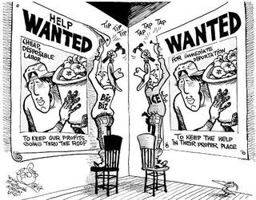
President Obama’s Executive Action On Immigration

Slide 2
The Immigration Debate
Immigration is a heavily debated issue.
Article 1 Section 8 Clause 4 gives Congress Naturalization Powers.
Every President since the late 1800’s has had to decide how to enforce immigration policy.
Congress has not made new immigration laws since 1990.
President Obama said he would use his Executive Order privilege if Congress could not develop and pass a bi-partisan immigration reform bill.

Slide 3
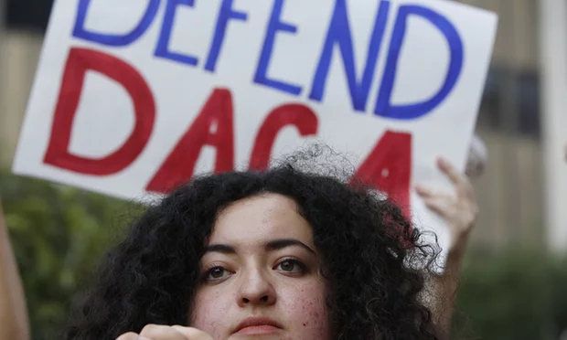
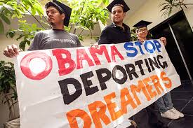
Executive Action and Immigration Reform
On November 20, 2014, President Obama announced a series of executive actions
*Refer to DREAM Act and DACA timeline handout
Notes:
DACA: to people of any current age who entered the United States before the age of 16 and lived in the United States continuously since January 1, 2010, and extending the period of DACA and work authorization from two years to three years.
DAPA: in a new Deferred Action for Parents of Americans (DAPA) and Lawful Permanent Residents program (LPA), provided they have lived in the United States continuously since January 1, 2010, and pass required background checks
Other Initiatives: Expanding the use of provisional waivers of unlawful presence to include
the spouses and sons and daughters of lawful permanent residents and the sons and daughters of U.S. citizens
Modernizing, improving and clarifying immigrant and nonimmigrant visa programs to grow the economy and create jobs
Promoting citizenship education and public awareness for lawful permanent residents
and providing an option for naturalization applicants to use credit cards to pay the application fee

Slide 4
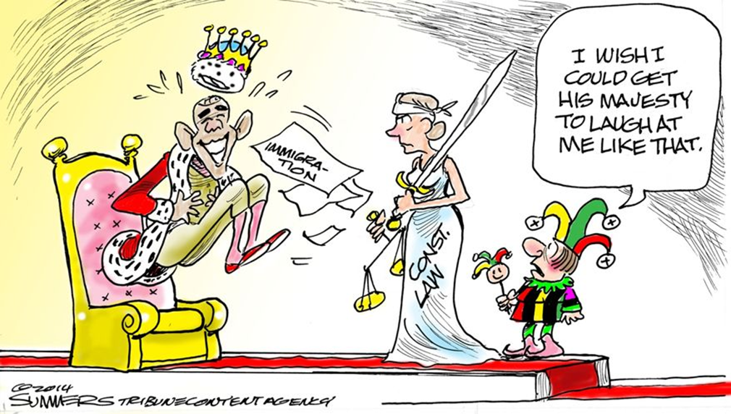
The Constitutional Question
Was President Obama within his powers with this Executive Order?
Was he simply implementing/enforcing the law?
Or, was he changing the law?

Slide 5
The American Response
U.S. Supreme Court hearing
DAPA was proposed in November 2014, but the U.S. Court of Appeals Fifth Circuit implemented a temporary block against it in February 2015.
Twenty-six states signed a brief against DAPA, which essentially sued the Obama Administration for the program.
The Supreme Court’s verdict is the final decision whether or not the program will be implemented.
The 4-4 SCOTUS tie handed down in June, 2016 essentially left in place the appeals court ruling blocking the plan.

Slide 6
Structured Academic Controversy
Was president obama’s executive order on immigration constitutional?

Slide 7
Three Constitutional Questions to Consider
Does the 2014 and the expansion of the 2012 program go beyond the powers that Congress has given to the President and his aides under federal immigration laws?
Did the President violate the constitutional command that he carry out federal laws “faithfully”?
Did President Obama create a new status for immigrants or did he make a group of undocumented immigrants “legal”?

Slide 8
Round 1
Read your assigned article for your assigned perspective (yes or no).
With your partner, list 5 strong reasons from your article to support your assigned position.
Each team presents five strongest arguments to opponents
Opponents write down arguments in #2 on scaffold
Clarifying questions are encouraged

Slide 9
Round 2
Groups rotate and switch perspectives.
Read the opposing article from what you read in Round 1.
With your partner, list 5 strong reasons from your article to support your assigned position. Try to find new reasons that were not discovered during Round 1.
Each team presents five strongest arguments to opponents
Opponents write down arguments in #2 on scaffold
Clarifying questions are encouraged

Slide 10
Round 3
Teams released from any assigned roles
You are now the 9th justice on the Supreme Court. How will you vote? Was the executive order constitutional?
Prepare to justify your vote with reasons and criteria.

